Slide 1


ADVANCING CROP PROTECTION INDUSTRY ROLE IN INNOVATION AND AGRICULTURAL PRODUCTIVITY
GLOBAL GAP TOUR STOP, NAIROBI, KENYA
MARCH 2023

Slide 2




Slide 3

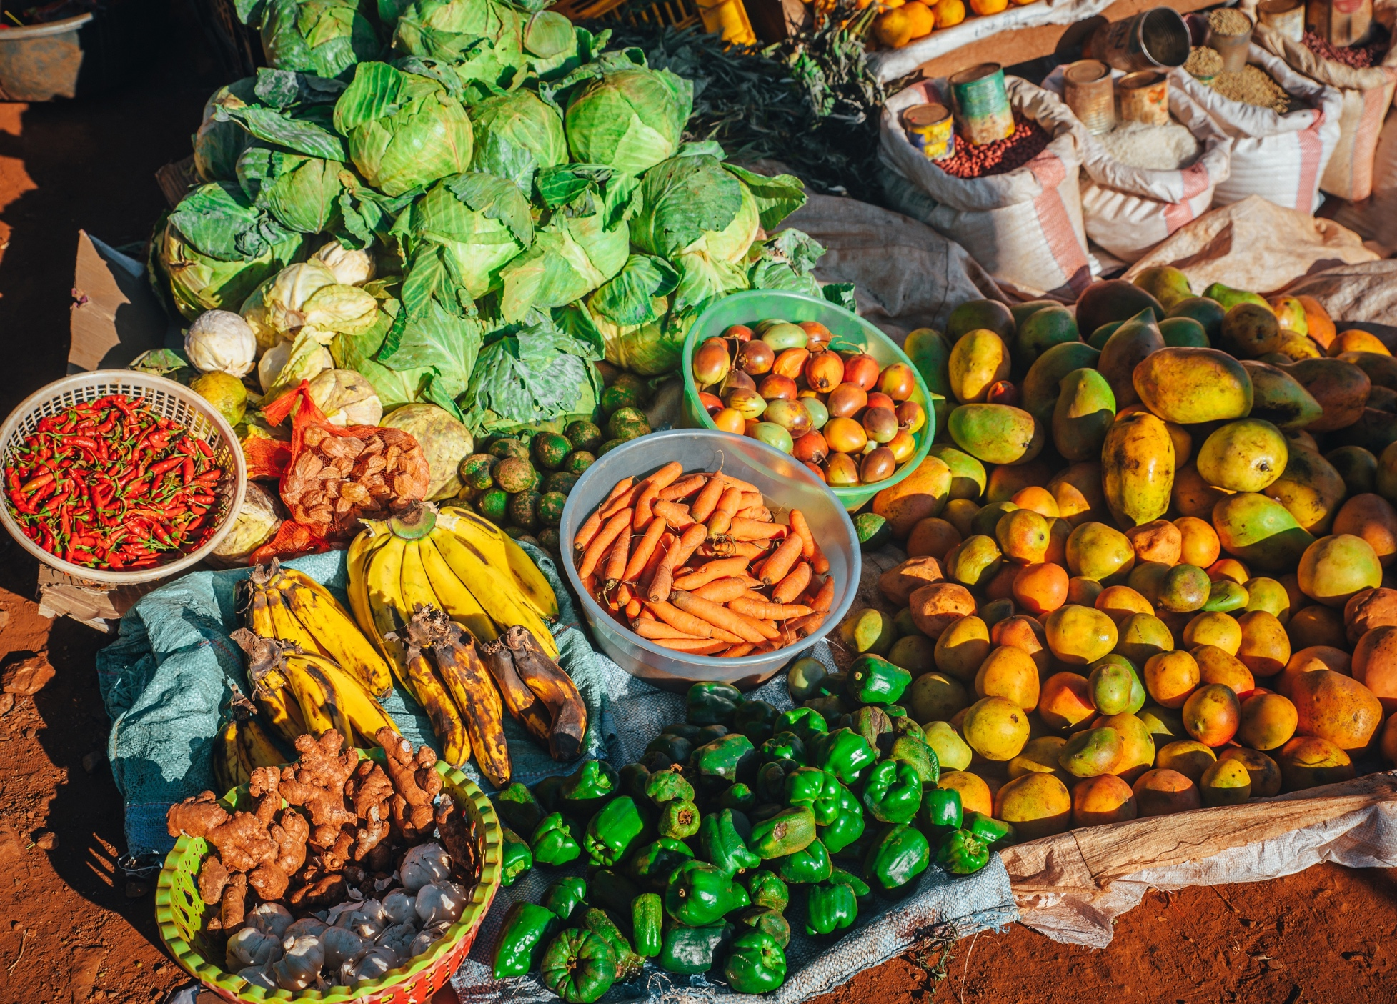
Climate change, land fragmentation, poverty and poor policies have complicated the production of food.
The average African farm currently performs at 40% of its optimum potential,
Africa is home to more than half of the world’s population facing food insecurity
Science and technology have continued to record tremendous advances in the field of agriculture.
From the use of ash, oils and sulfur in 1930’s to modern discoveries with precision use of pest control Products using drone technologies
Pests and diseases persists and have evolved with the changing global climate- Emerging pests.
INTRODUCTION

Slide 4
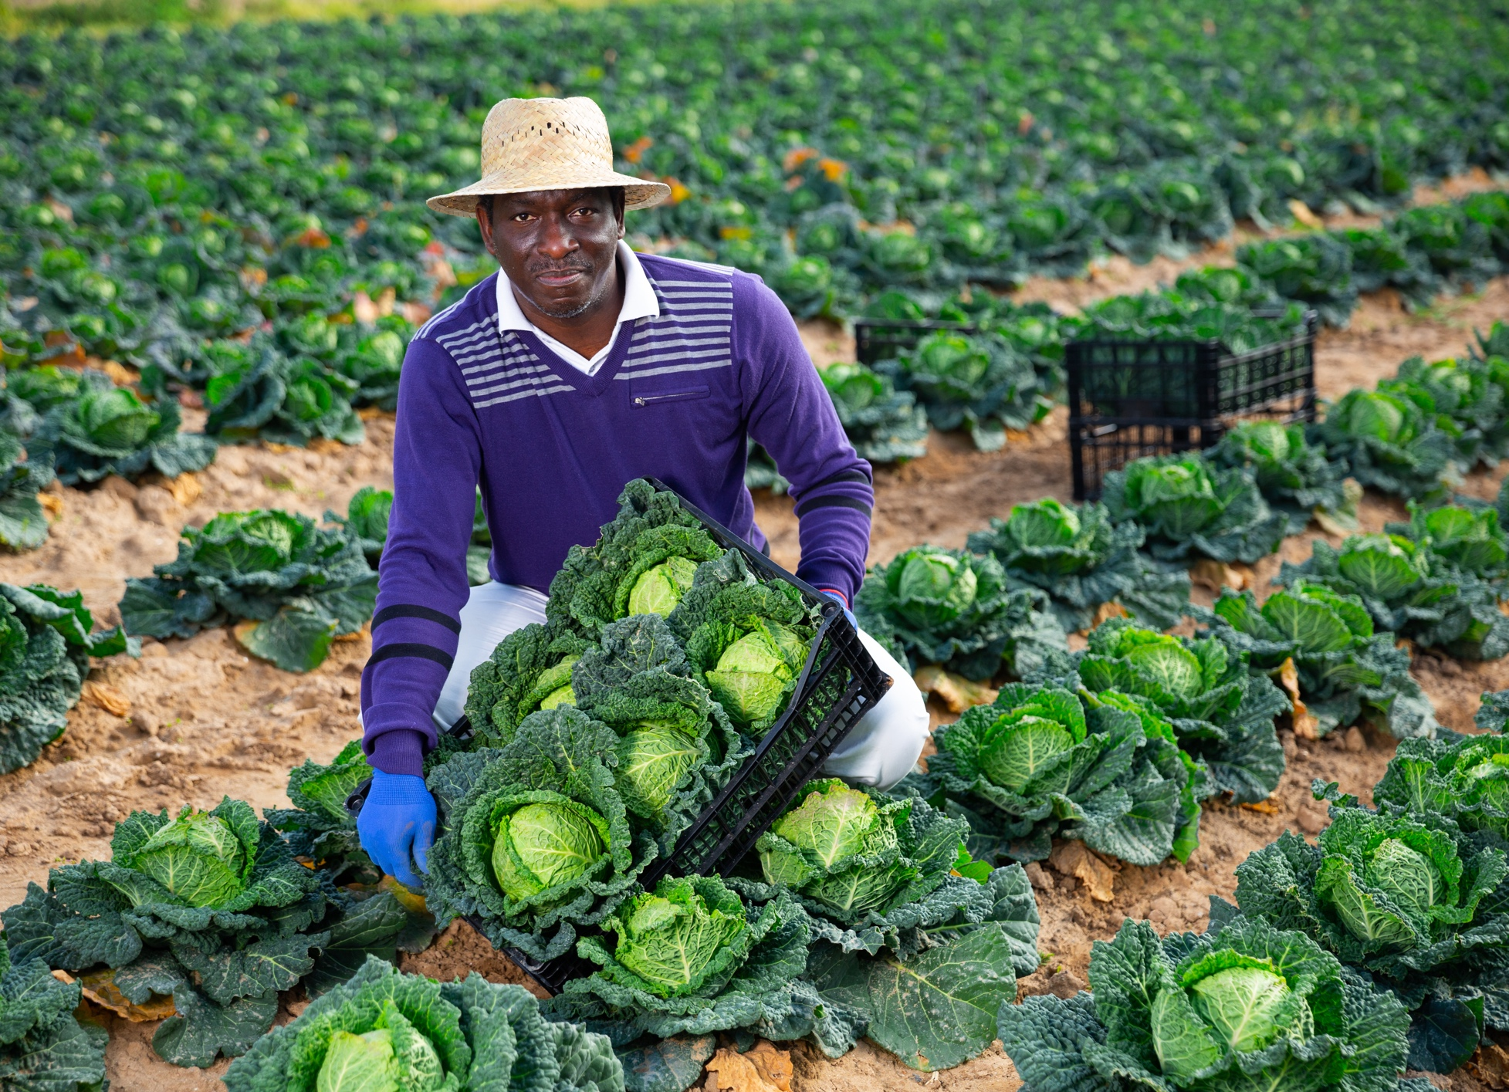
SPMF strategy Combines best practices in regulatory and stewardship, creates an enabling environment for innovation, and builds an infrastructure that supports sustainable pesticide management through improved incident reporting, container management programs, Obstocks management and anti-counterfeit activities.
Provides farmers information and training on responsible crop protection practices and access to innovative technologies that protect human health and the environment and optimize crop production.
The SPMF goes beyond standard farming training to introduce new ways to empower farmers to adapt to and mitigate the effects of climate change through new application technologies.
This is a collaborative approach with local and global partners including government bodies, farmer groups, and civil society to change farmer behavior towards sustainable pesticide management.
Industry initiative and focus on sustainable pesticide management framework (SPMF)

Slide 5

SPMF activities are focused on three key pillars to achieve sustainable pesticide management:
Reducing the reliance on Highly Hazardous Pesticides (HPPs),
Through better risk assessment approaches at regulatory level.
Through an enhanced regulatory framework that facilitates strategic decisions and by building the capacity of local regulators in science-based risk assessment.
2. Increased innovation –
Making innovation available to farmers, extending access to new and existing solutions including low risk products, label extension
3. Effective & responsible use of pest control products-
Equipping farmers with information and best practices
sustainable pest management integrate all measures available to the farmer (the “pest control tool kit”)-Integrated pest management (IPM)-cultural methods (e.g. ploughing), biological control (e.g. using so called “natural enemies of pests”), physical methods (e.g. traps) and choice of crop varieties that are resistant to pests.
Compliance to GAPs
Use of SSP’s
Industry initiative and focus on sustainable pesticide management framework (SPMF

Slide 6
Through research and innovation companies are striving to bring sustainable technologies to farmers, that increase yields sustainably, and to train farmers on the correct and safe use of technologies: -
Industry Innovations to Expand the farmer’s toolbox for Pest Management production

Slide 7
Provide industry support towards label extension for minor crops
Support towards crop grouping extrapolation to enhance the farmers toolbox for pest management
New registrations for Low-Risk products to protect/preserve forests/biodiversity and other natural habitats
New crop varieties are being designed to use less water and to be more tolerant of droughts, heatwaves, and salinity from ocean flooding.
Industry Innovations to Expand the farmer’s toolbox for Pest Management

Slide 8
Increased monitoring, advocacy, awareness and demand for safe food by the general public
Stringent Regulatory approvals and post-registration surveillance for PCP’s
Regulators requires risk assessment/mitigation measures
Development of laws requiring professionalized provision of pest control products to farmers
Enhanced traceability of produce to pinpoint and avoid residues- Notifications on Quarantine pests and MRL’s
Demand for environmental sustainability and industry taking responsibility for management of waste and plastic packaging-Extended producer responsibility regulations.
New bill on food safety coordination –for all agencies dealing with aspects of food safety
Regional harmonization of approval guidelines/study protocols- EAC harmonization
Increased governance of Pest Control Products

Slide 9
Maximum Residue Limits (MRLs) are a trading standard and a measure of the highest level of a pesticide residue that is legally tolerated in or on food or feed when pesticides are applied correctly.
MRLs are set well below levels of human health concern to ascertain that foods produced with pesticides are suitable for consumption
MRLs are the cornerstone to trade. National MRLs established in many countries which differs with codex MRLs complicates market access.
For MRLs set at limit of detection, establishing achievable import tolerance is an uphill task.
Trade facilitation, Market access and MRLs

Slide 10

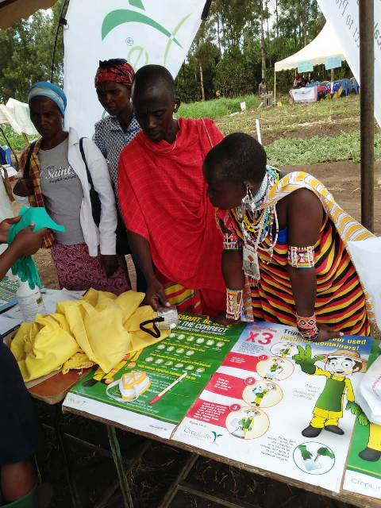
Capacity building for
MRL compliance
Focus on GAP and approved label requirements
Training Interventions to enhance compliance for areas affected by notifications and interceptions ( Machakos, Kirinyaga, Kajiado)
Training for export-oriented farmers in emerging growers in Western and North Rift Kenya.
Key partners in outreach such as Farm Africa, DanChurch Aid, CABI, VegPro, FPEAK,FPC among others.

Slide 11
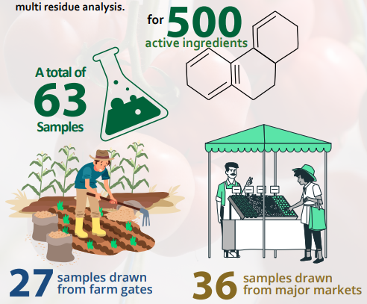
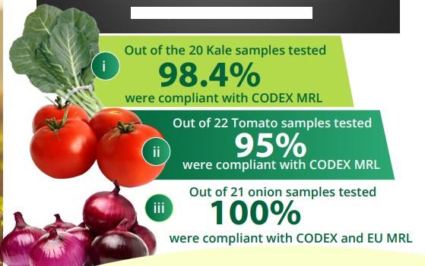
MRL MONITORING AND SURVEILLANCE
Survey conducted in 2022 in key horticultural growing areas of Kajiado, Nakuru and Nyandarua.
Similar findings from other studies by partners.

Slide 12
Spray Service Providers development
SSP’s Mainly targeting small scale farmers including the horticulture Value chains
Over 1,920 trained in 14 Counties
SSP’s have enhanced compliance to Global GAP pesticide use guidelines and preferred pesticide lists.
Avoidance of Counterfeit/Illegal products resulting from a streamlined supply chain
Less exposure for the farmers.
Enhanced monitoring on PHI for MRL compliance
Enhanced container and waste management for environmental compliance.

Slide 13




DIGITAL OUTREACH AND PARTNERSHIPS
Partnerships to enhance knowledge on responsible use of pesticides.
SMS outreach to over 100,000 farmers
Radio shows in vernacular stations discussing responsible Pesticide Use
Social media campaigns on R.U. With partners
Digital content development on key subjects such as PPE use, Disposal of Containers and Use of SSP’s.
Collaborations and partnerships with certification bodies to better market access

Slide 14
DIGITAL OUTREACH AND PARTNERSHIPS
For producers, IFA helps to improve farm management, raise the efficiency of farm operations, protect environmental resources, and enable access to international markets through compliance with a globally recognized standard.
For supply chain stakeholders, sourcing from IFA certified production helps to ensure food safety, mitigate reputational risks, protect product integrity, demonstrate commitment to responsible farming practices, and enable reliable and trusted supply that addresses all major consumer demands

Slide 15
Our sector through the revamped SPM strategy is part of the solution through offering technology and innovation that should be viewed as enablers to achieve a green transition towards sustainable food systems while maintaining food security and therefore achieving the SDGs.
There is need to fully unleash the potential of plant science, such as: -
Promotion of sound agricultural policies and on-the-ground investment in research and innovation - Collaboration with leading technology providers to create powerful solutions for customers, increase high quality food production, and poverty reduction –
Creating a conducive regulatory environment that enables the deployment and adoption of innovations - Improve linkages along the food and agriculture value chain and outside of the agriculture industry for new kinds of collaborations and innovation –
Increase regional integration and invest substantially in infrastructures, agricultural research, new technologies (both biotechnology and mechanical) and extension services. - Improve policies to enhance access to necessary seed and plant science technologies.
Conclusion

Slide 16
THANK YOU

