Slide 1
GLOBALG.A.P. Tourstop: Kenya
TOPIC :
Benchmarking versus localg.a.p. – when is it necessary
Nairobi, Kenya
28-30 MARCH 2022

Slide 2
Benchmarking

Slide 3
BENCHMARKING OPTIONS
Benchmarked:
Equivalent
Checklist
Scheme
GLOBALG.A.P.
General Regulations
GLOBALG.A.P.
General Regulations
Scheme
management rules
GLOBALG.A.P.
Principles
and criteria
Modified checklist
Scheme
G.A.P. criteria
© GLOBALG.A.P. Secretariat | ‹#›

Slide 4
COMPARED SCHEMES
Compared Schemes
They are not benchmarked schemes
Systems that cover the GLOBALG.A.P. system requirements to a large extent but leave some exceptions
Only desk review, no benchmarking process
Different regulations than benchmarking
No right to use the GLOBALG.A.P. IT systems to register producers
GLOBALG.A.P.
Certification rules
GLOBALG.A.P.
Principles & Criteria
Certification rules
Scheme G.A.P. requirements
© GLOBALG.A.P. Secretariat | ‹#›
Notes:
NOTES FOR THE TRAINER:
Certification systems that cover the GLOBALG.A.P. system requirements to a large extent but leave some exceptions can apply to be listed as a compared scheme on the GLOBALG.A.P. website without benchmarking recognition or the right to use the GLOBALG.A.P. IT systems to register producers.

Slide 5
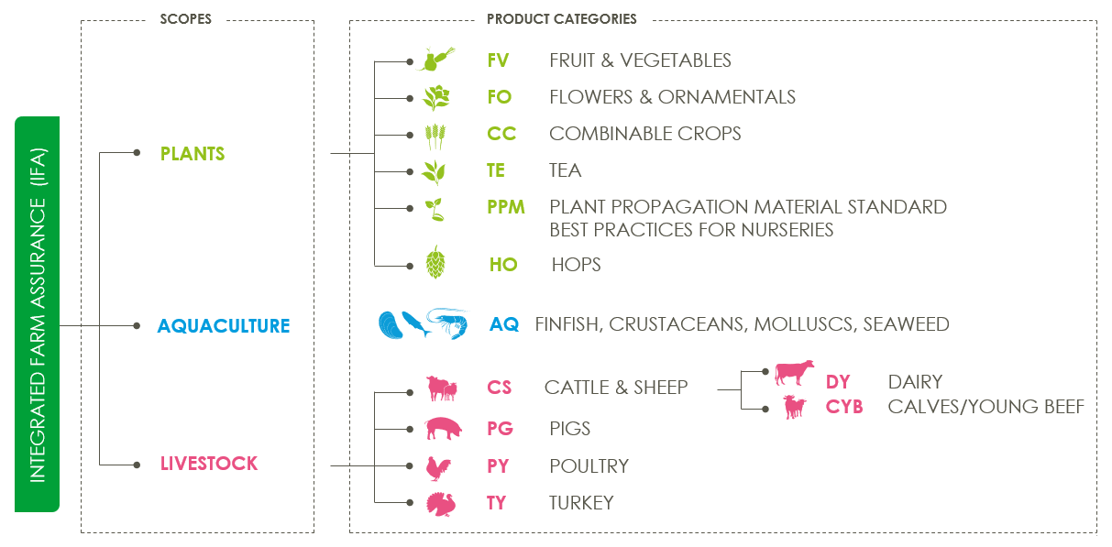
BENCHMARKING PRODUCT CATEGORIES
BM approval per product category and not per scope
✔
✔
✔
No re-benchmarking for livestock
© GLOBALG.A.P. Secretariat | ‹#›

Slide 6
BENCHMARKING Purpose
Benchmark certification status….
allows for international recognition….
cuts duplication….
reduce costs
© GLOBALG.A.P. Secretariat | ‹#›

Slide 7
BENCHMARKING Product categories and recognition
 | Benchmarked scheme | Benchmarked checklist
Fruit and Vegetables
Flowers and Ornamentals
Pigs
Hops
* Resembling + Supplement: A scheme that has achieved benchmarked status by developing a supplement to cover the remaining GLOBALG.A.P. general regulations and the product-specific principles and criteria which are not included in the original scheme documents. Only producers who have been audited to the standard and the supplement are issued with a GLOBALG.A.P. Number, listed in the GLOBALG.A.P. IT systems, and have a benchmarked certification status.
Updated December 2022
Notes:
NOTES FOR THE TRAINER:
Here we present the list of fully conforming GLOBALG.A.P. benchmarked schemes and checklists and the list of resembling schemes

Slide 8
localg.a.p.

Slide 9
What is localg.a.p.?
Producers
Buyers
Capacity building tool
Local/Regional implementation
Local standard
Retailers
Processors
Distributors
Restaurants
Small-scale
Emerging
© GLOBALG.A.P. Secretariat | ‹#›

Slide 10
Capacity Building
End goal defined
by market
Cannot go backwards
GLOBALG.A.P. certification
Intermediate Level
Foundation Level
Entry Level
© GLOBALG.A.P. Secretariat | ‹#›
Notes:
Three main levels (EL, FL, IL). Any other level is not an official level of localg.a.p.
End goal ideally GG, but could also be another level defined by market
Must always progress towards a goal over a period of time – never backwards. Or if producer has been on GG before – then cannot use lg as program.

Slide 11
localg.a.p. Primary Farm Assurance | GLOBALG.A.P. Integrated Farm Assurance
Assessment | Certification
LGN | GGN
Subset of IFA requirements with three levels: Entry Level Foundation Level Intermediate Level | One level with a full set of requirements
Approved certification bodies/verification bodies | GLOBALG.A.P. approved certification bodies
Letter of conformance | Certificate
Focus on local markets and capacity building | Suitable for export market
Benchmarking not possible | Benchmarking possible

Slide 12
National Interpretation Guideline (NIG)

Slide 13
National Interpretation Guideline (NIG)
Developed by the National Technical Working Group (NTWG)
Make the GLOBALG.A.P. standard LOCAL
Provide guidance to producers
Incorporates the legal requirements
Becomes the normative documents to be used by CBs when auditing
in a specific country
© GLOBALG.A.P. Secretariat | ‹#›

Slide 14
THANK YOU TO ALL OUR SPONSORS!
© GLOBALG.A.P. Secretariat | ‹#›

Slide 15
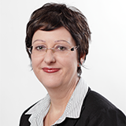
THANK YOU FOR YOUR ATTENTION!
Questions – Discussion – Contact Us
Name: Christi Venter
Senior Technical Expert /
Team Leader Training Development
venter@globalgap.org
www.globalgap.org

Slide 16
Disclaimer: This presentation, training material, or publication is the property of GLOBALG.A.P. c/o FoodPLUS GmbH. The GLOBALG.A.P. approved Certification Body or Registered Trainer may use it and its content in internal and external trainings in unaltered format. GLOBALG.A.P. does not assume any responsibility for the training carried out by third parties using this material.
© GLOBALG.A.P. Secretariat

