Slide 3
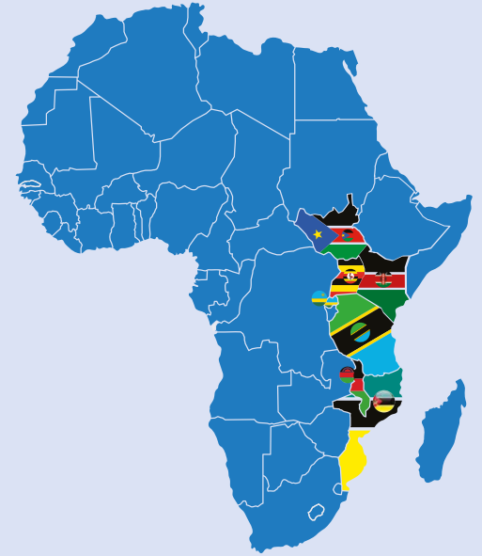
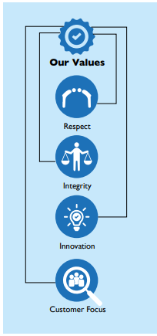
Our Footprint
Britam is a leading diversified financial services group listed on the Nairobi Securities Exchange with presence in seven countries in Africa namely; Kenya, Uganda, Tanzania, Rwanda, South Sudan, Mozambique and Malawi.
01|
Our Vision
To be the leading diversified financial services company in chosen markets across Africa.
02|
Our Mission
Providing customers with financial security EVERY STEP OF THE WAY.
03|
Our Purpose
Safeguarding dreams and aspirations
04|
Our Brand Positioning
With you every step of the way.

Slide 4
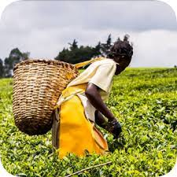
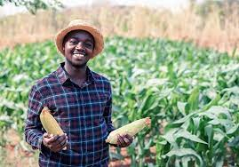
Britam Emerging Markets & Consumers
Informal Workers & MSMEs
Low income households, Small Holder Farmers, emerging businesses, registered groups, welfare associations, Saccos
Digital Products
Millenials, Generation Z, Telcos, Emerging businesses, start-ups, Platform workers
Climate Insurance
Crop Insurance, Flood Insurance , Pastoralist Livestock Insurance

Slide 5
Insurance Solutions for Small Holder Farmers

Slide 6
Kinga Ya Mkulima
Kinga ya Mkulima is wholesome family medical and life cover.
The cover has been sold and marketed to small holders from 2007
It is majorly for tea farmers and welfares/groups of small holder farmers
600,000+ Insured lives
The product caters for inpatient medical, surgery, maternity and funeral expense benefit.
It covers both the farmer and his/her dependents.
The premium is as low as 55/= per month for the basic benefit package

Slide 7
Crop Insurance
Crop insurance is a climate risk management tool for mitigating financial risks for farmers by providing financial compensation for lost or damaged crops.
It helps farmers to recover from natural disasters and other insured perils and to continue operating their farms.
It helps farmers get access to credit
It also helps to stabilize food supplies and prices.
The main crops that are insured in Kenya include maize, wheat, rice, and horticultural crops such as vegetables and fruits.

Slide 8
Area Yield Index Insurance
A seasonal crop insurance that is based on the average yield of a particular crop in a specific area.
Farmers are insured against losses due to low yields caused by natural disasters or other unforeseen ievents ( Drought, hail damage, frost damage, fire, excess rainfall, windstorms, malicious damage, uncontrollable pests and diseases)
The insurance payout is determined by comparing the actual yield in the area to the average yield in that area over a certain period of time.
Cost-effective and efficient way to provide crop insurance coverage to farmers.

Slide 9
Weather Index Insurance
A seasonal crop insurance that is based on weather data, such as rainfall or temperature.
Farmers are insured against losses due to weather-related events such as drought, floods, or storms.
The insurance payout is determined by comparing the actual weather data to a pre-determined set of weather conditions specified in the insurance policy.
Cost-effective and efficient way to provide crop insurance coverage to farmers.

Slide 10
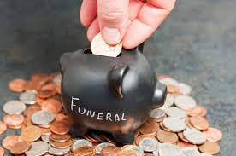
Group Insurance Products
Benevolent
This is a combined last expense, Personal accident & Hospitalization benefit cover.
Target Market : Registered Saccos/Groups/Lending Organizations/MFIs
Afya Tele
This is a unique group medical insurance with an inbuilt funeral benefit.
Target Market: SMEs, Micro finance institutions, Sacco’s, chama’s and Self Help Groups.
Credit Insurance
This is an insurance policy designed to pay off a borrower’s debt if the borrower dies.
Target Market: Registered Saccos/Groups/Lending Organizations/MFIs
5

Slide 11
Impact
SDG 1.4 (No Poverty): Provided access to affordable and innovative insurance products to over 1.5Million low and lower-middle income individuals with monthly household income ranging from $100-$450.
SDG 3.8 (Good Health & Well Being): Insured over 0.8M lives and paid over $25Million in health insurance claims to reduce out-of-pocket expenses with an aim of reducing financial risk related to health care.
SDG 5.a (Gender equality): Expanding access from insurance by having 48% of all insured as women in the products.
SDG 8.10 (Decent Work & Economic Growth): Expanding access to health, crop life & accident insurance protection to over 400,000 workers and households in Kenya.

