Slide 1
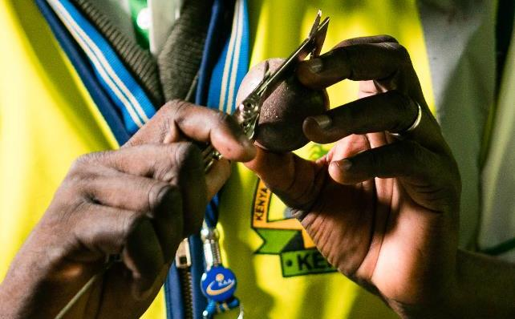
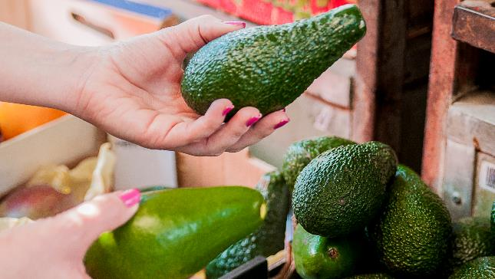
Gaps to market access for Kenya’s agricultural produce: how is COLEAD intervening sustainably?
GLOBALG.A.P. TOURSTOP NAIROBI 29th MARCH 2023

Slide 2
01. FROM COLEACP TO COLEAD
COLEAD
GROWING PEOPLE
COL Committee Linking
E Entrepreneurship
A Agriculture
D Development
COLEAMA (1973)
COLEACP (1976)
COLEAD (2023)
Notes:
NOT-FOR-PROFIT ASSOCIATION : COLEAD is a private sector interprofessional association established in 1973 by stakeholders in the international fruit and vegetable trade
PURPOSE : To facilitate and implement all actions allowing, directly and/or indirectly, to increase the contribution of the agricultural sector, and horticulture in particular, to the achievement of the SDGs
APPROACH : COLEAD manages and implements development programmes (approx. 15) in the agriculture and food sector, funded by donors, amongst which the EU is the most important
Support to private and public sectors through technical cooperation and capacity building, mainly in ACP countries (currently 50)
SUSTAINABILITY : COLEAD and its members are committed to maintaining the highest standards of respect for human rights and the environment

Slide 3
02.
OUR APPROACH
Demand-driven
Capitalise on previous programmes and outputs
Holistic in our methodology
Representative through our actions (pilot value chains)
Impact driven
Information for decision-making

Slide 4
02.
PARTNER BENEFICIARIES – VALUE CHAIN APPROACH
Farmer organisations
Value chain actors
Research institutes
Value chain actors
Civil Society
Service Providers
(consultants)
Producers, processors, traders, exporters
(MSMEs)
Competent authorities
Professional Organisations
Public-Private Stakeholder Platforms
Laboratories
Sister organisations
Training centres - Universities

Slide 5
02.
COLEAD PROGRAMMES ACTIVE in KENYA
RECENTLY CLOSED
UNDER IMPLEMENTATION
LAUNCH PHASE
ACP countries
Horticulture
2016-2021
Kenya
Horticulture
2020-2025
EU partner countries worldwide
Agricultural value chains
2022-2026
CLOSING PHASE
ACP countries
Horticulture + other (indirect)
2021-2026
ACP countries
Horticulture
2019-2022/2023

Slide 6
03.
EVOLVING EU TRADE AND
MARKET ACCESS REQUIREMENTS

Slide 7
03.
Evolving requirements
TRENDS IN STANDARDS AND REGULATIONS
MAIN ISSUES
Food Safety
Social
Plant Health
Environment
1999
2022
drivers
Pesticides
Labour, gender
Invasive pests
Climate change
Major changes in control of production & supply
Overhaul & strengthening of national SPS regulations, among other EU Plant Health Law (in force 2019)
Dramatic increase in private standards & certifications
Notes:
It is important to bear in mind that private sector operators face an array of other demands as well.
The absolute bottom line for buyers when dealing with suppliers is: price, reliability and consistency of supply, and quality
Over and above this, produce must comply with the regulations in force in the destination country (domestic or 3rd country). And they may be supplying different markets that have different requirements.
High-end markets (especially retail - supermarkets) + niche markets, are likely to require certification with private standards.
These are self-governing systems around industry codes of practice , based on compliance and 3rd party certification.
EAC exporters supplying most EU markets will have to be certified to a number of private standards covering food safety and good agricultural practices (e.g. BRC, GLOBALG.A.P.); social and labour practices (e.g. ETI, BSCI) and (increasingly) the environment (covering water, GHG emissions, among others).
These standards are often more stringent than regulations. In theory “Voluntary” but in practice compulsory in order to do business
This diagram summarises the way regulations and standards have evolved over the past 20 years. Globalisation has led to major changes in control and supply of foods, including strengthening of national regulations (particularly SPS), and a dramatic increase in the use of private standards. This has left operators facing an increasingly complex – and costly – set of demands:
In the late 1990s, a series of food safety incidents led to an overhaul of food safety regulatory frameworks in several major markets (including the EU). This was followed by the development of private voluntary standards to enable and demonstrate compliance (e.g. GLOBALG.A.P.).
From the mid-2000s, following some high-profile incidents of unethical practices (and negative press), exporters increasingly faced demands to demonstrate good social and labour standards, often though certification with civil society or private certification schemes
In the 2010s, the spread of some serious invasive and harmful pests (e.g. fruit fly, fall armyworm) led to stricter plant health rules in major markets, creating challenges for operators as well as national competent authorities
In the 2020s, the focus is on sustainability. This began with mainly civil society-led certification & individual label schemes, but is now becoming a more integral part of mainstream certification
In the 2020s, we are also seeing major changes to government policies and regulations, reflecting growing global awareness of the environmental crisis we all face due to climate change, pressure on water resources, plastic pollution, and soil degradation, among others
The landscape is becoming increasingly challenging for 3rd country suppliers

Slide 8
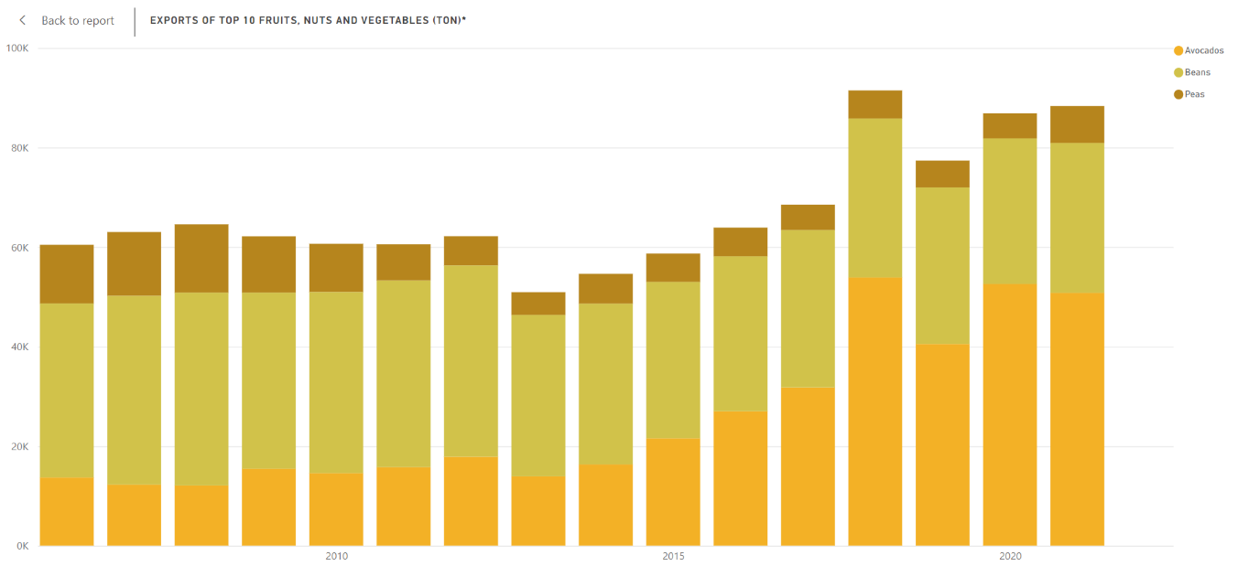
03.
Export trend from Kenya to EU27+UK
2010 - 2021
Growth in volumes due to avocado (15k t – 50k t)
Stagnation in beans exports since 2013 (30k t – 32kt )
Stagnation in peas exports since 2013 (5 – 7 k t)
Export of fresh produce from Kenya to EU27+UK (filtered for main fresh exports avocado, beans, peas).
Source: COLEAD Trade dashboards: https://kenya.coleacp.org/kenyan-horticultural-sector

Slide 9
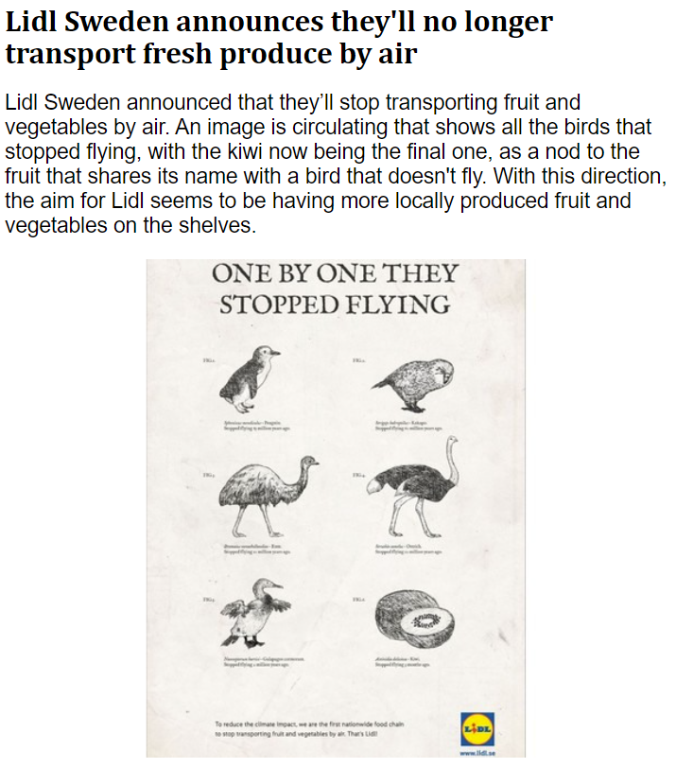
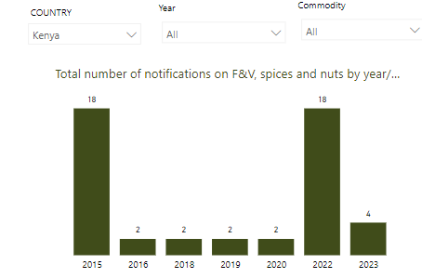
03.
Examples of changing external environment
Fresh Plaza, 13 Sept 2022
RASFF Portal, COLEAD dashboard

Slide 10
03.
Accessing EU markets
A very complex landscape of regulations and standards for producers and export companies, with significantly increased costs
Important for exporters, BMOs and regulators to be aware of and understand the challenges; it affects the ability of producers and exporters to meet requirements, as well as the financial viability of doing so.
A consequence of all these changes is that less “demanding” markets are becoming more attractive.
It also creates opportunities for operators who can “jump through the hoops”, making them more able to access a variety of markets, including profitable niche markets

Slide 11
03.
COLEAD interventions
Providing up to date information
Technical assistance and trainings changes on new and evolving requirements

Slide 12
03.
TOPICS COVERED
NEW PLATFORM
A new portal bringing together information on recent and upcoming changes to EU policies, regulations & standards
Targeted communication to competent authorities & business organisations alerting to changes and actions needed
A contact point for further information
Environmental
management
Business management
& development
Training
methodologies
Scope: All agricultural value chains linked to the EU market (food & feed of non-animal origin, animals & products of animal origin, plants & plant products, focus on agri-food
Partner beneficiaries: Competent authorities; business membership organisations (BMOs) and national farmer organisations
Geographical scope: 143 low-income, lower-middle and upper-middle-income economies
Sustainable
Production & trade
Food safety
Plant health
Social accountability
& empowerment
Agricultural production
& processing
Visit : https://agrinfo.eu/

Slide 13
03.
COLEAD interventions
Providing relevant and up to date information
Technical assistance and trainings on new topics and evolving requirements
Advocacy, representing and providing platform for ACP point of view:
E.g. WTO SPS Committee
Standard Setting Bodies, e.g. testing of GLOBALG.A.P. V6 in Kenya & Ghana
Webinars and Innovation Series
Sustainability Self-Assessment System for MSMEs, collecting data, anticipating new requirements, facilitating decision-making
Supporting public-private dialogue, in Kenya through National Horticulture Taskforce

Slide 14
ASANTE SANA !
THANK YOU VERY MUCH !
Useful links:
COLEAD online learning platform (free): https://training.colead.link
COLEAD trade and interceptions dashboards: https://www.colead.link/analytics
NExT Kenya programme: https://www.colead.link/current-programmes/next-kenya
Agrinfo website: https://agrinfo.eu
Contact: wester.schepers@colead.link

