Slide 1
Mark-Up Kenya
Impact on Kenya’s
Trade Competitiveness and Market Access
Notes:
Some lesson learnt and best practices from MARUP KENYA, and scalable options for future interventions (e.g Markup2)
This story I am telling you starts with the Creation of synergies by bringing the national government regulatory authorities, the county extension systems and private sector to work together is key for success and sustainability of interventions

Slide 2
Mark-Up Theory of Change
Increased Value
Chain Productivity
& Compliance
Quality Policy,
Leg. and Reg.
Framework Alignment
Improved Livelihood
through Increased
Regional and international
Trade
Skills Development, Extension Services
Quality Infrastructure, Conformity Assessment
Recognized Standards/Techn. Reg. Conformity
Productivity, Value Addition
Export DiversificationEAC,
Middle East, Europe
Enhanced Access
to Regional and International Markets
Farmer, Women Empowerment

Slide 3
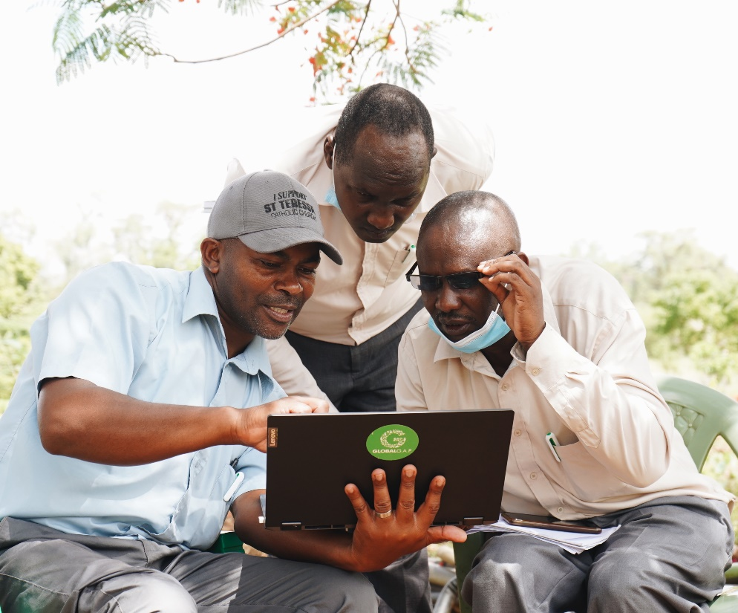
Lesson learnt 1- Market driven training and skills development An effective model of transferring food safety knowledge to smallholder farmers and consumers
Notes:
MarkUp focused on training of extension services , lead farmers, champion farmers, opinion leaders in their community.
They interpret information received from technical research, development agencies, media and government institutions→ and deliver fit for purpose training

Slide 4
Lesson learnt 2-increasing productivity for community empowerment Increased income generation is the key behavioral drive that motivates smallholder farmers to adopt food safety practices in Kenya
Notes:
Farmers that followed market driven trainings reported increased productivity and revenue increase.

Slide 5
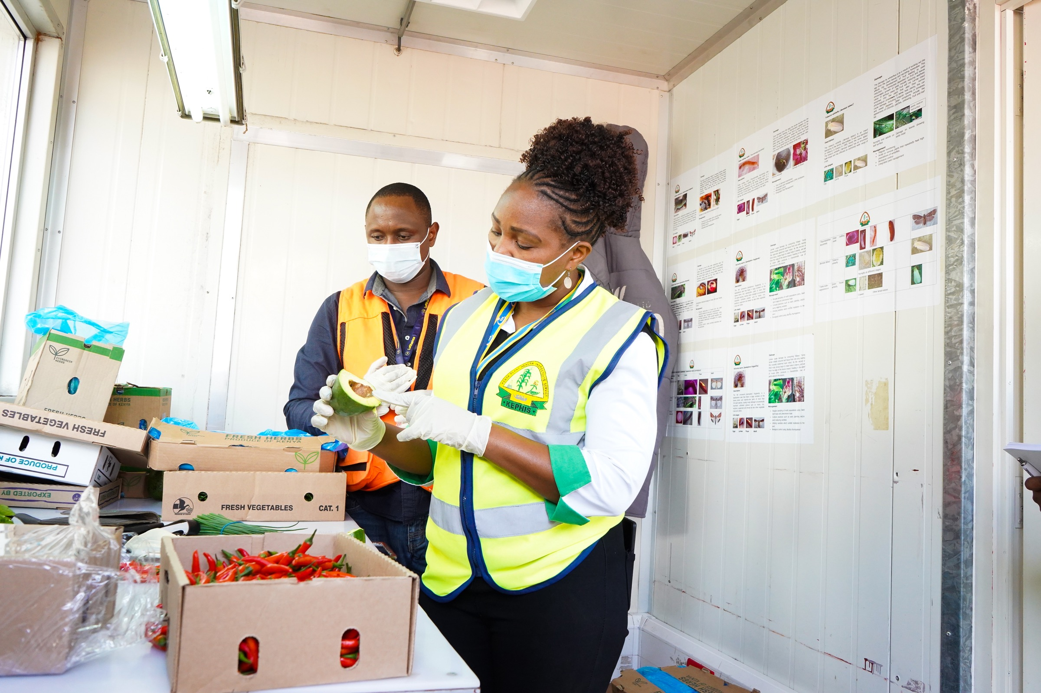
Lesson learnt 3-Adehrence to standards secure access to markets and better prices, but it is costly Improved food safety (e.g GAP) lower cost to prove compliance with market requirements
Notes:
Certification is a continuous process which requires constant adherence to standards and regular audits, which is costly. However, adherence to the standards ensures ready access not only export markets and better prices which leads to greater profitability and improved community welfare as a result of increased revenues .for ex. Reduction of post harvesting losses

Slide 6
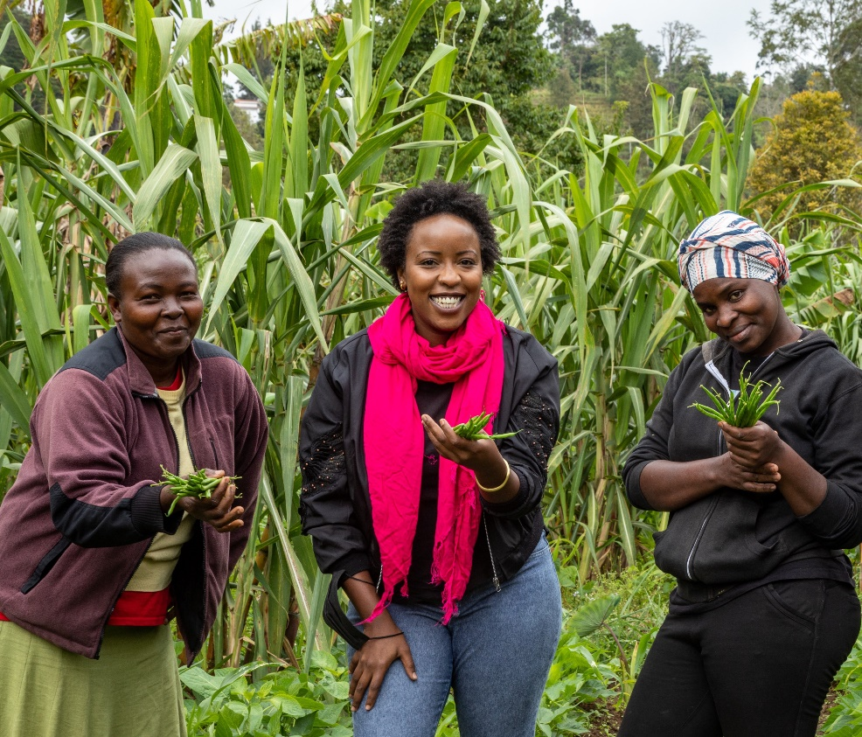
Lesson learnt 4- Bridging the Gender and Age Divide Empowering women and youth farmers as food safety champions in Kenya
Notes:
Processors and County Governments have specifically targeted women and youth in selected activities and initiatives.
Youth led the way in practicing food safety- 96% of 488 youth respondents demonstrated a high level of engagement and commitment towards adopting and promoting food safety practices.
9% of the female farmers interviewed reported they could export up to 50% of their products after receiving and practicing MARKUP food safety communication messages.

Slide 7
MARKUP Kenya Impact: Extension officers and farmers capacity building
This resulted in the training of
1,416
35
The outcome of the training resulted in contract farming for 500 groundnut farmers in 2 counties i.e.
300 in Siaya and 200 in Busia.
One SME certified to export Avacado in Transzoia county
MARKUP trained
Farmers/ Producers
County Extension Officers as GlobalGAP Assurer Experts
on GlobalGAP across value chains
Projection : scaling up GAP trainings to 100,000 farmers /producers in more counties, would lead to massive increase market access opportunities resulting in jobs creation, increased incomes , poverty reduction in rural areas and overall economic development.
Notes:
Zoom in
2 SCALABLE OPTIONS for the REGION
-Engaging farmers through extension services and lead farmers
-Communicate widely on food safety focusing practical aspects that can help to increase revenue in addition to protect the consumer.
Scale of 40
RECCOMENDATIONS
a) Access to international markets remains a challenges and future export development interventions should support contract farming and strengthen linkages for better
market access
b) Need for continuous technical training on GAP and supporting linkage of trained farmers/producers with reliable offtakes
c) explore approaches to ensure sustainable means of accessing and maintaining necessary certifications such as GlobalGAP, Rain Forest Alliance, etc
d) There is need to encourage risk-based approaches in conducting inspections and support joint official inspections by relevant government agencies.

Slide 8
A scalable impact of the MARKUP Kenya
MARKUP empowered farmers, inspection services in various counties and central agencies in few selected value chains
94%
92%
71%
69%
67%
44%
Extension officers & farmers disseminated the knowledge other farmers
Farmers and beneficiaries adopted food safety/ GAP measures.
Farmers reduced produce losses by applying food safety/ GAP measures
Increased productivity
Farmers experienced
revenue growth
Access to New Markets
20%
Reduction in pest infestation
** Endline KAP Survey covered a sample size of 638 farmers in 6 counties.
Notes:
Lets’ look at the same story using some figures and highlighting the best practices
Empowering farmers with support of extension services and in synergy with gov agencies indusced a positive impact of revenue growth and access to new markets
We believe this model can be scaled to the region and beyond horticulture
→ for example KALRO has developed appropriate integrated pest management options which are environmentally friendly, and can control these two pests. These include: pheromone traps, field sanitation, use of attractants, and soft chemical. These technologies are being disseminated to farmers would reduce infestation by at least 20%.

Slide 9
MARKUP Kenya impact : Outreach on key quality and safety issues in horticultural sectors
12.7
Youth interacted with the Mazao Talks podcast, increasing interest in agribusiness activities.
5.9
Pesticide Awareness Campaign through Bulk SMS, mass media & digital media.
2.7
Sensitization and Awareness campaign on Aflatoxin management and control
REACH
Million +
Million
Million
Mass Media
Website
176
48
Released 12 episodes
11 Twitter Spaces (8680 listeners)
3 Webinars (3978 listeners)
3 newspaper articles.
56,000 downloads
Media Appearances
Blog Posts
34 News Pieces published/ broadcasted on TV, Radio & Newspapers over the reporting period.
Website traffic for the reporting period:
1,507 visitors
2,024 page views
Notes:
Communicate widely on food safety focusing practical aspects that can help to increase revenue in addition to protect the consumer.
RECCOMENDATION -Websites and social media alone are not sufficient to reach massive outreach.
-There is need for wider and more consistent dissemination of information and guidelines on practical aspects of food safety (e.g. safe use and storage of pesticides)
-Involvement of relevant Government ministries, departments and agencies is key to successful implementation of projects. Therefore, it is important to invest in building and strengthening relations and communication with relevant Government representatives for ownership and sustainability. Partnership with and support for research institutions such as KALRO is essential to ensuring the availability of clean planting materials to increase yield, quality and control of pests and diseases.

