Slide 1
TOUR Stop Kenya 2023
Looking into the future –
Our engagement with Africa
Dr. Kristian Moeller
Managing Director

Slide 2

THANK YOU TO ALL OUR SPONSORS!

Slide 3

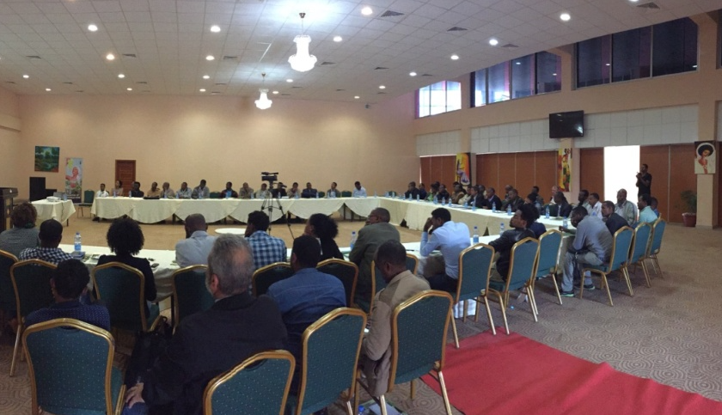
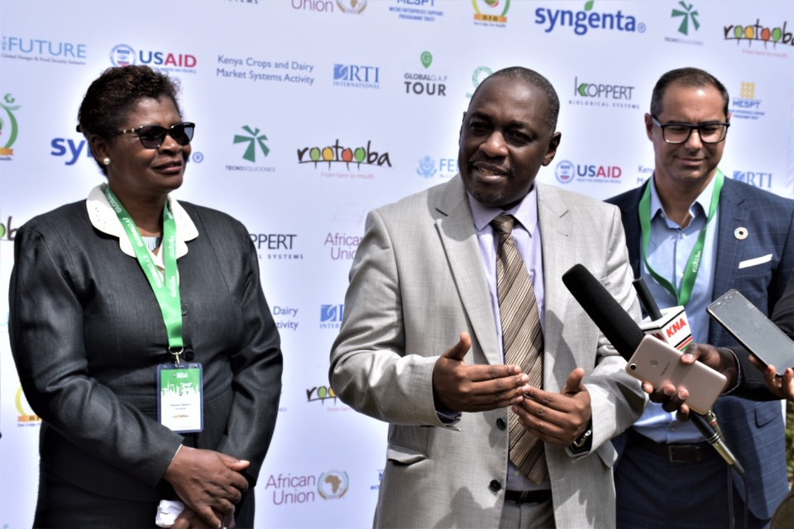

PAST TOUR STOPS in Africa
Malawi, Lilogwe
Uganda, Entebbe
Ghana, Accra
South Africa, Cape Town
Ethiopia, Addis Ababa
Ethiopia, Addis Ababa &
Awassa
Egypt, Luxor
Nigeria, Leggi
Togo, Lomé
Ethiopia, Bahir Dar &
Mekelle
Kenya,
Nairobi
Tanzania,
Arusha
Kenya,
Nairobi
2015
2016
2017
2019
2022
2023
Nigeria 2017
Notes:
East Africa: Lilogwe, Malawi& Entebbe, Uganda
Accra, Ghana
Cape Town, South Africa
Lomé, Togo
Luxor, Egypt

Slide 4
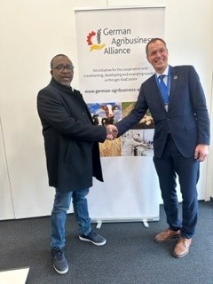
MEETING WITH KENIAN AGRICULTURAL MINISTER MITHIKA LINTURI in January 2023 in Berlin

Slide 5








HOLISTIC APPROACH TO FARM ASSURANCE
Voluntary Standard – Certification - Benchmarking
FOOD
SAFETY
FRUIT & VEGETABLES, CROPS
FLOWERS &
ORNAMENTALS
ENVIRONMENTAL
SUSTAINABILITY
AQUACULTURE
WORKERS
WELLBEING
Source: GLOBALG.A.P.
Notes:
Link to presentation of Christi, she will go into detail

Slide 6

IFA FOR FRUIT AND VEGETABLES
Part of a portfolio of solutions
Combine add-ons and assurance as required.
For example:
Consumer label
RMS
Produce Handling Assurance
BioDiversity
Chain of Custody
GRASP
BioDiversity
GRASP
GRASP
IFA v6
Fruit and vegetables
IFA v6
Fruit and vegetables
IFA v6
Fruit and vegetables
IFA v6
Fruit and vegetables
IFA v6
Fruit and vegetables
Business to
Business
Business to Consumer

Slide 7
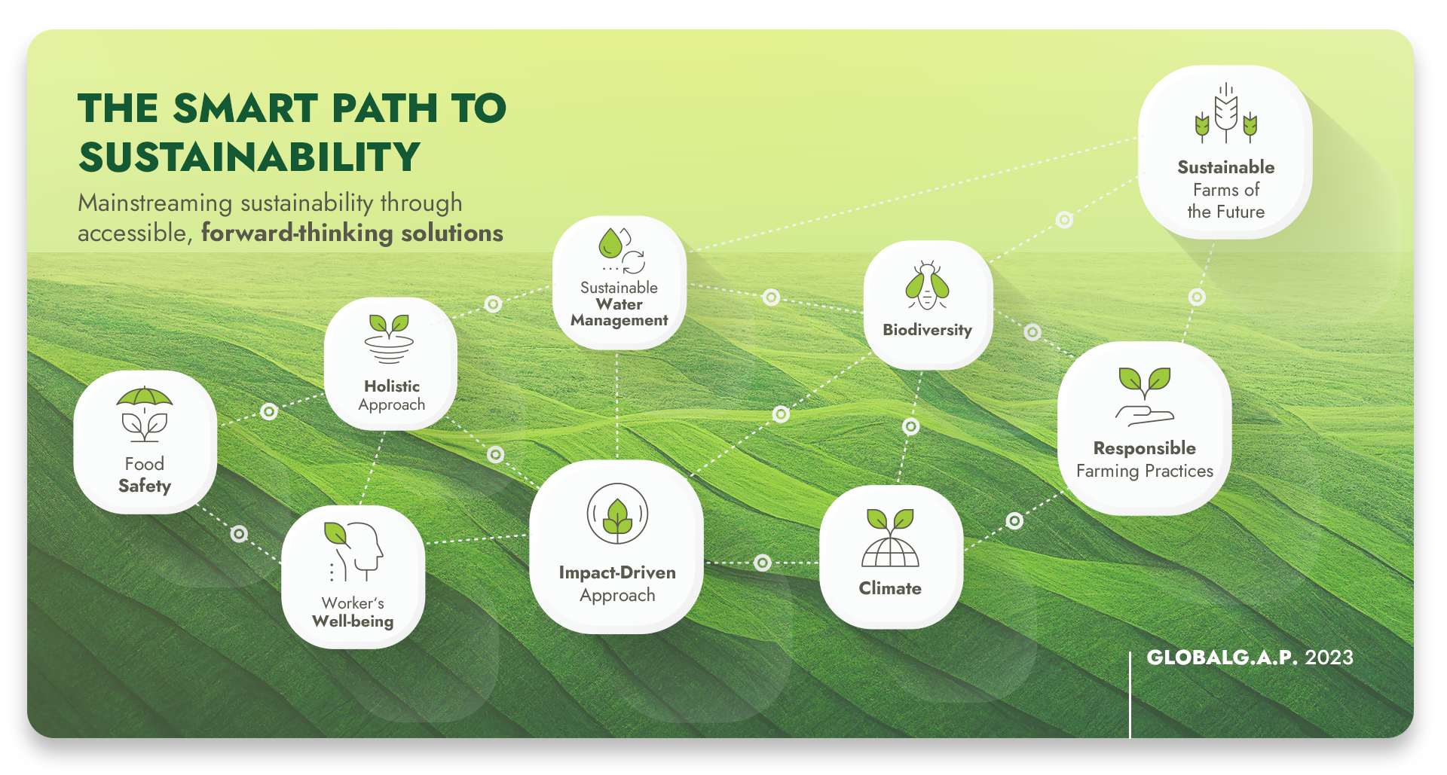
MAPPING “THE SMART PATH TO SUSTAINABILITY”

Slide 8
GLOBALG.A.P. INTEGRATED FARM ASSURANCE CERTIFICATION
Certified hectares of non-covered and covered crops worldwide
Updated 31 December 2022

Slide 9
EMERGING MARKETS FOR CERTIFIED PRODUCE
Certified hectares of non-covered and covered crops in Kenya
TOP 5 PRODUCTS
(by ha)
Avocado
Green Bean
Pineapple
Baby Corn
Mangetout
*update 28 Feb 2023
Notes:
Product Certified Non-Covered Crops in ha (first & further harvest)
Avocado 4.661,3 ha
Green Bean 3.533,4 ha
Pineapple 2.177,6 ha
Baby Corn 1.282,2 ha
Mangetout (pea pod) 1.147,3 ha

Slide 10
EMERGING MARKETS FOR CERTIFIED PRODUCE
Certified hectares of flowers and ornamentals in Kenya
*update 28 Feb 2023

Slide 11
IFA CERTIFIED PRODUCERS IN EAST AFRICA
Overview of IFA certified producers between 2018-2023
 | 2018 | 2019 | 2020 | 2021 | 2022 | 2023*
Ethiopia | 155 | 171 | 390 | 114 | 112 | 31
Kenya | 28,098 | 28,130 | 25,028 | 20,133 | 4,744 | 4,304
Rwanda | 2 | 26 | 2 | 4 | 4 | 4
Uganda | 3 | 3 | 2 | 3 | 2 | 13
Tanzania | 1,041 | 1,186 | 1,692 | 1,148 | 149 | 796
Up to 31 January 2023
© GLOBALG.A.P. Secretariat | ‹#›

Slide 12
IFA CERTIFIED PRODUCERS IN EAST AFRICA
Top 3 product under GLOBALG.A.P. certification
 | 1 | 2 | 3
Ethiopia | Cut flowers | Cut flowers (PPM) | Strawberries
Kenya | Avocados | Green beans | Cut flowers
Rwanda | Common beans | Capsicums (chilli/pepper) | Avocados
Uganda | Cut flowers | Bedding plants (PPM) | Cut flowers (PPM)
Tanzania | Avocados | Mangetout | Baby corn
Up to 31 January 2023
© GLOBALG.A.P. Secretariat | ‹#›
Notes:
Based on results from 31 January 2023

Slide 13



PARTNERING TO ADDRESS CHALLENGES
  Scoping Mission
  TOUR Stops
  Communication material
  Informative webinars
Awareness
Raising
  localg.a.p.
  GlobalG.A.P. Academy
  Educational material
  Farm Assurance Mentorship
  Study Tour
  Registered Trainer Program
integrating smallholders into sustainable value chains.
Capacity
Building
  Supporting NTWGs
  Translation of standard documents
  Supporting certification bodies
Certification
Facilitation

Slide 14
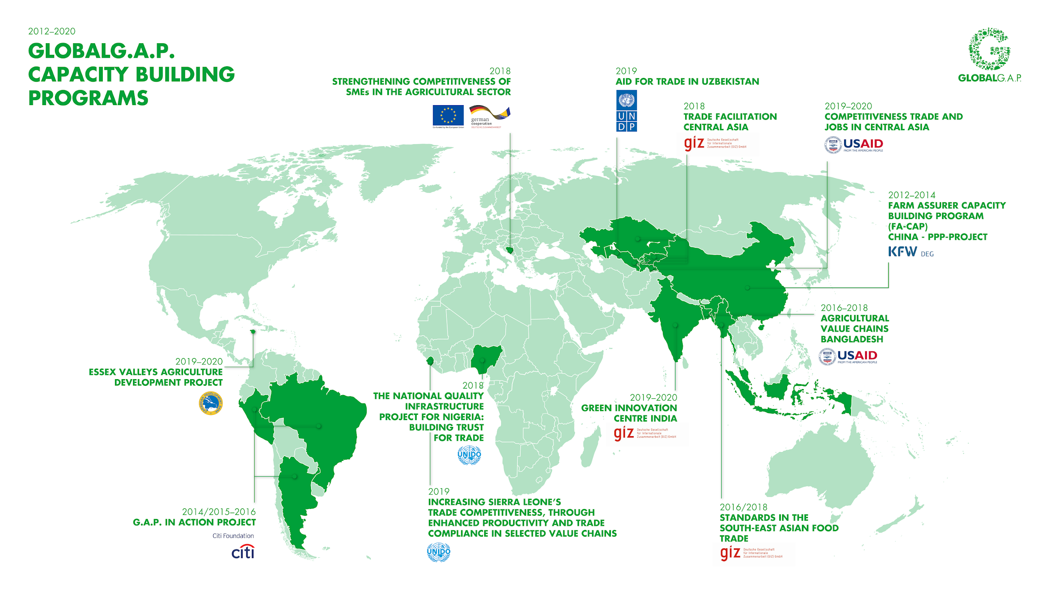



Slide 15
CAPACITY BUILDING PROJECTS in Africa 2020 – now
2020
2021
2022
now
Finnish Federal Development Agency: Tanzania “Quality Standards for Enhanced Market Access
for Small-holder Farmers in Tanzania”
UNIDO: Kenya
“GLOBALG.A.P. training of trainers and mentor- ship programme for selected horticulture value chains in Kenya”
UNDP: Lesotho “Support the government of Lesotho on farm assurers’ capacity building, adoption of good agricultural practices, standards setting and certification”
Namibian Agronomic Board: Namibia “Support for Namibia’s Food Control System for Agronomic and Horticultural Products”
IFC: Angola “GLOBALG.A.P. Capacity Building in Angola”
Bambara Nut “GLOBALG.A.P. Registered Trainer Supports the Export of New Superfood in Zimbabwe”
Zambia & Namibia “Meeting with Governments”
African Union “Support of the African Continental Free Trade Regime”

Slide 16
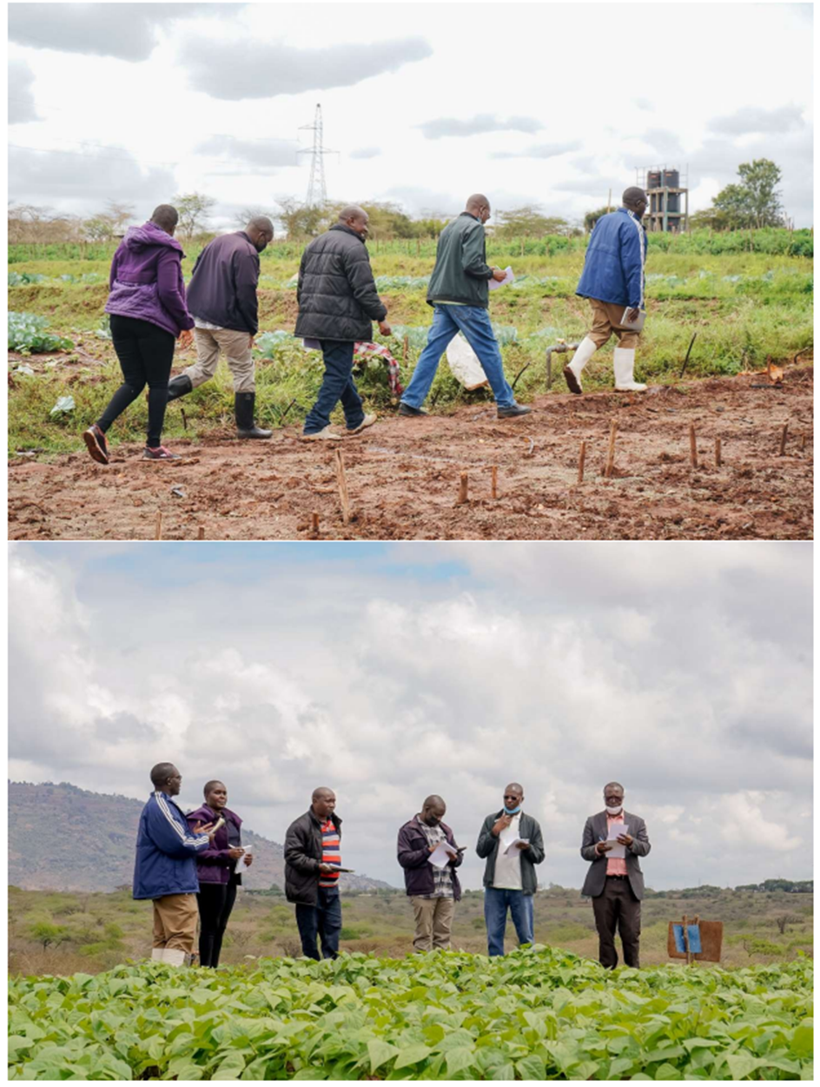
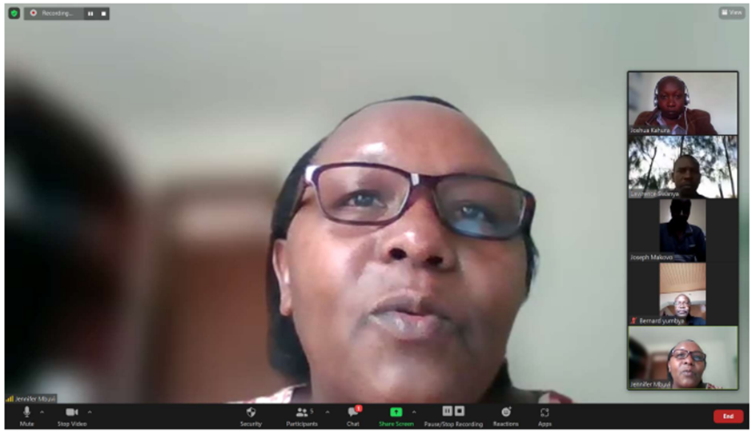

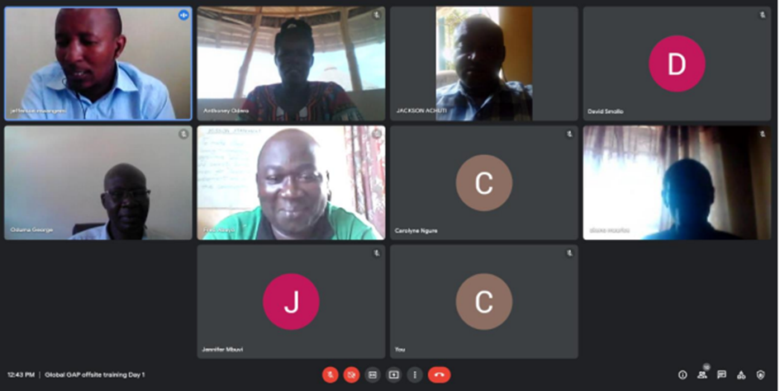
GLOBALG.A.P. TRAINING & MENTORSHIP PROGAMME for selected horticulture value chain in Kenya 2021 – 2022
United Nations Industrial Development Organization
Project ID: 180109
GLOBALG.A.P. training & mentorship programme for selected horticulture value chain in Kenya

Slide 17
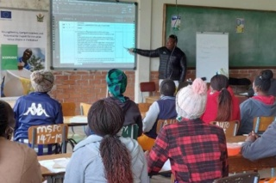
GLOBALG.A.P. REGISTERED TRAINER SUPPORTS EXPORT OF NUTS
Zimbabwe, Bambara Nut
Bambara nut set for European market
Registered Trainer Clarence Mwale supported Bambara nut in entering the European Market. 1,193 members from the Chivi and Gokwe districts will be registered as a GLOBALG.A.P. producer group

Slide 18
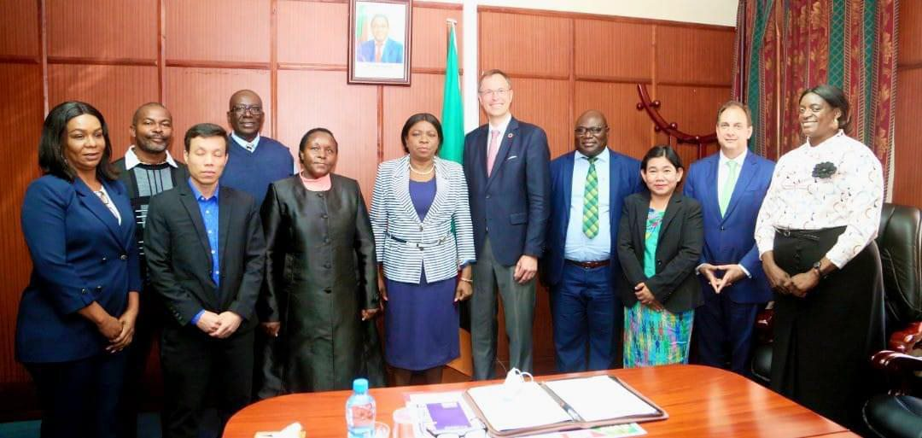
MEETINGS WITH GOVERNMENTS IN NAMIBIA AND ZAMBIA in 2022
GLOBALG.A.P. met with Her Honor the Vice President of Zambia in Lusaka to discuss the establishment of international standards for trade and the support of sustainable development in the country.

Slide 19

MEETINGS WITH GOVERNMENTS IN NAMIBIA AND ZAMBIA in 2022
The Namibian Ministry of Agriculture, Water and Land Reform welcomed the prospect of GLOBALG.A.P. certification in Namibia and recognized GLOBALG.A.P.’s efforts in collaboration and capacity development.

Slide 20

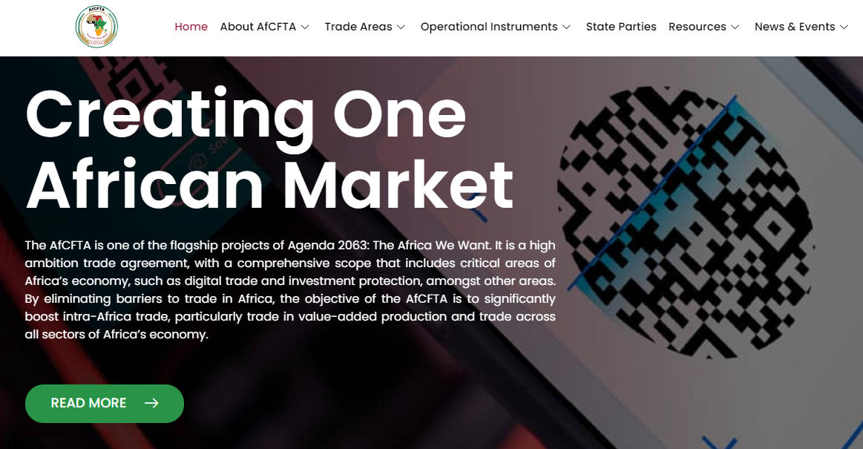
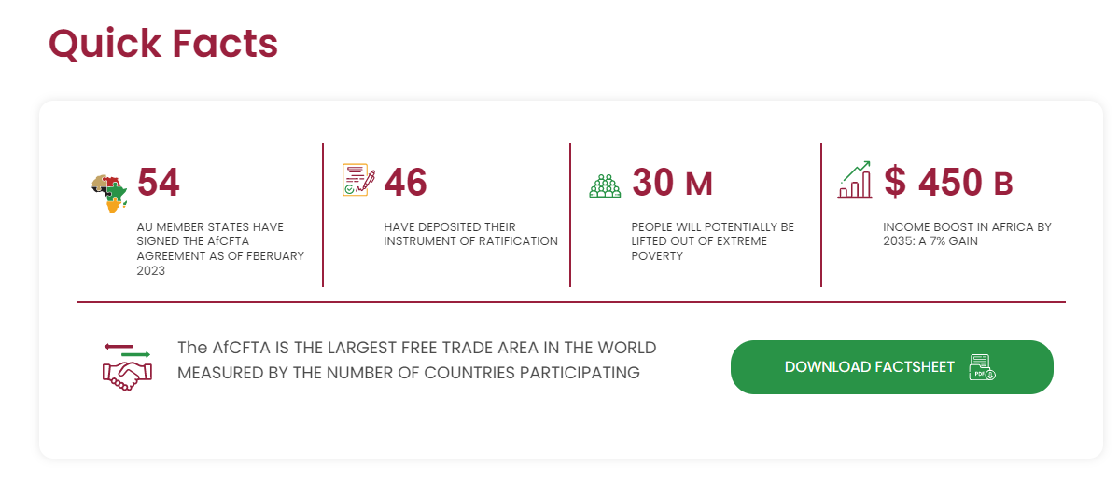
AFRICAN CONTINENTAL FREE TRADE AREA (AfCFTA)
https://au-afcfta.org/

Slide 21
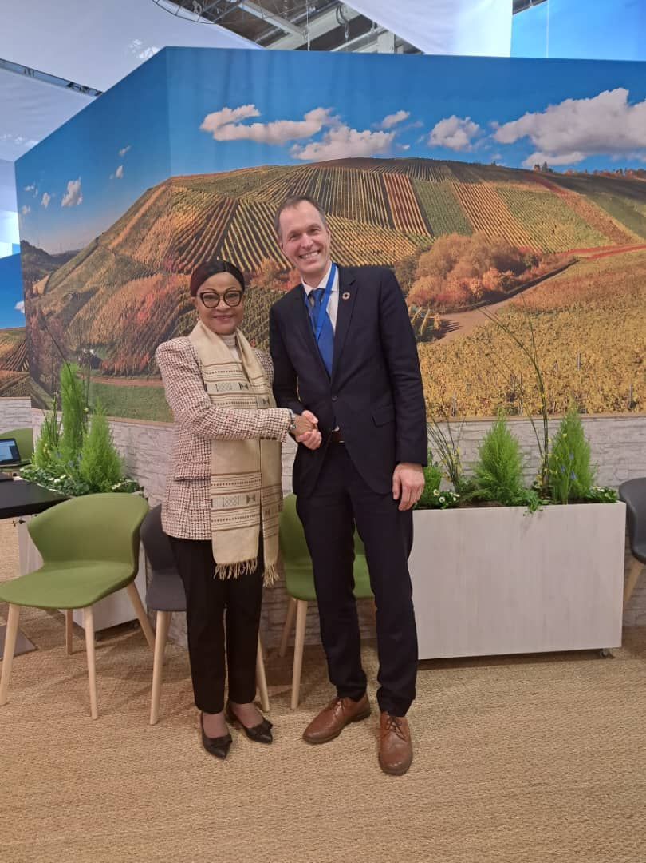
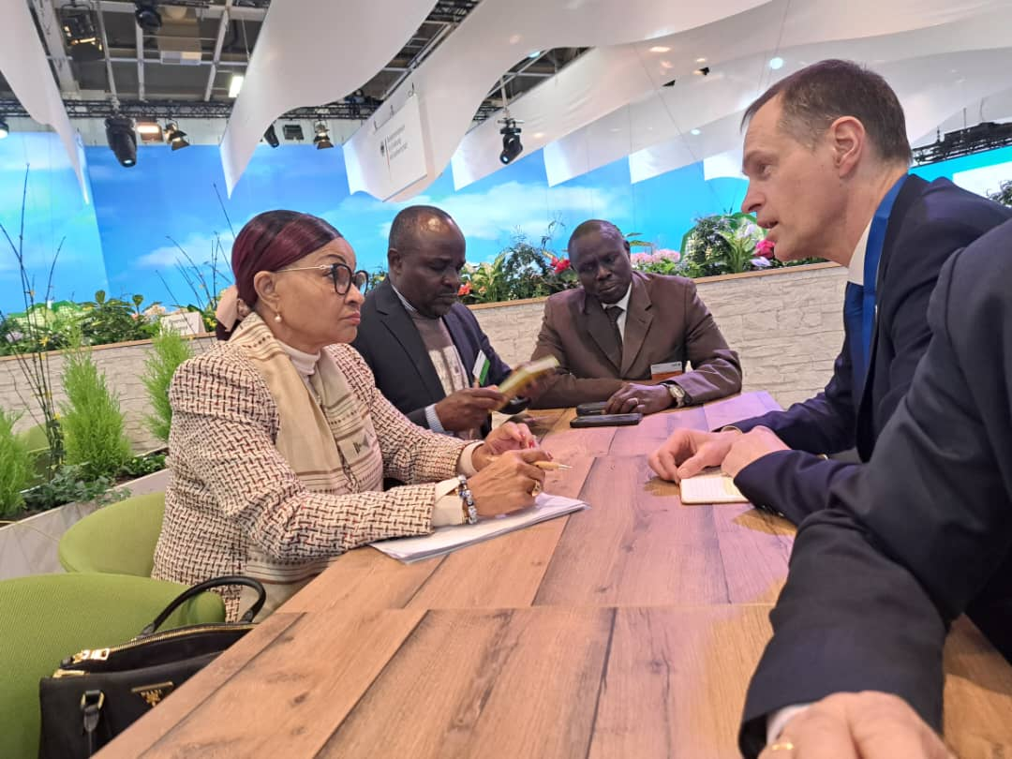
MEETING WITH H.E. AMBASSADOR JOSEFA SACKO in January 2023 in Berlin

Slide 22
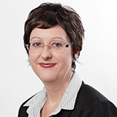
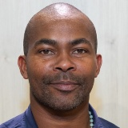
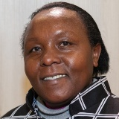
GLOBALG.A.P. STAFF ON THE GROUND
MAHINDA WAHOME
Technical Key Account Manager Ethiopia, Kenya, Tanzania, Uganda
CHRISTI VENTER
Senior Technical Expert
JENNIFER MBUVI
Key Account Manager Kenya

