Slide 1
Burton and Bamber Co. Ltd
Making standards work without increased burden on producers
Sourcing from smallholder farmers and the Global GAP challenge
March 2023

Slide 2
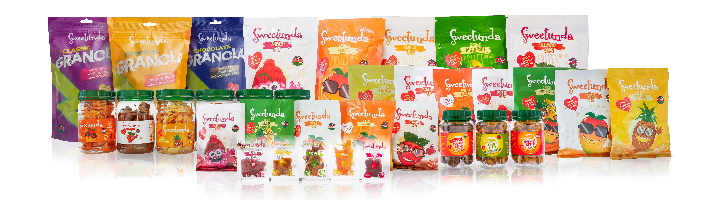
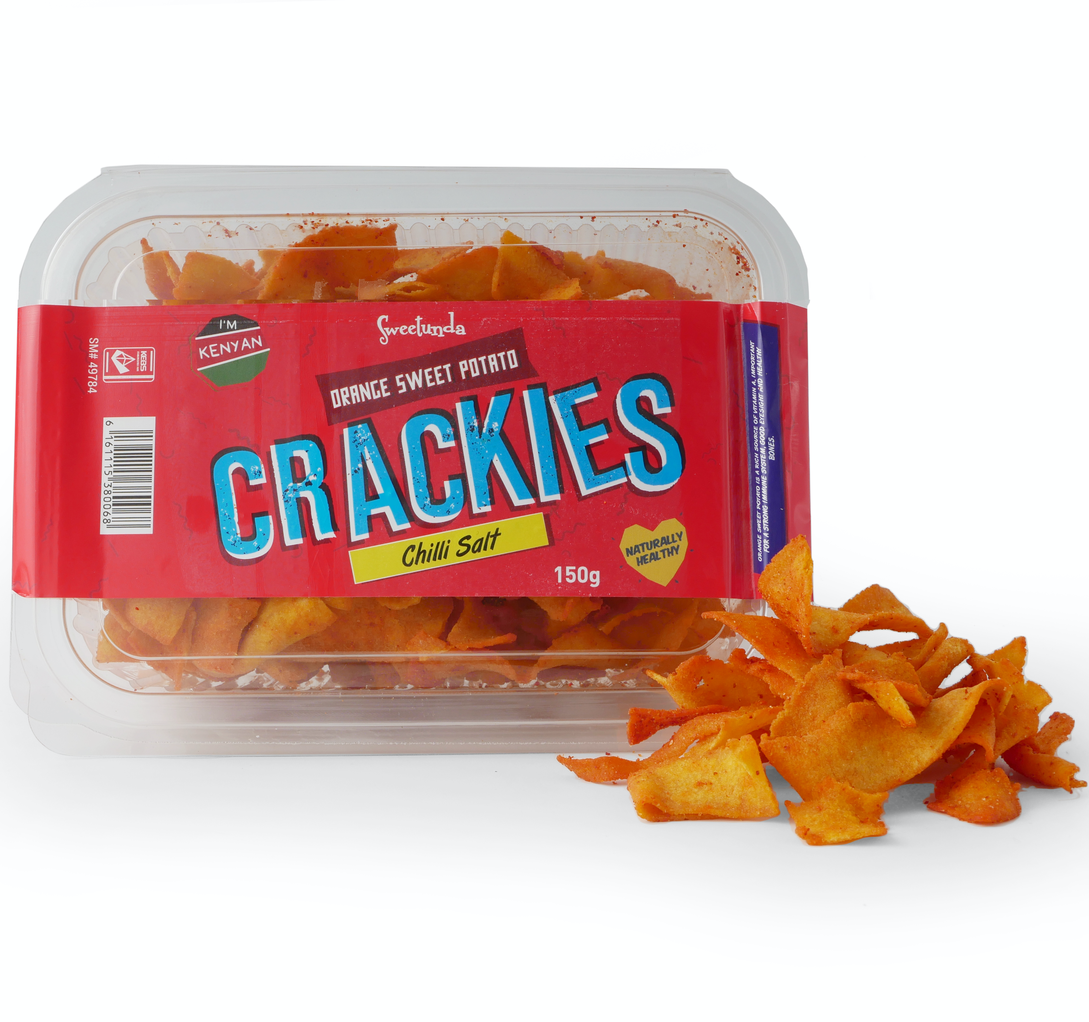
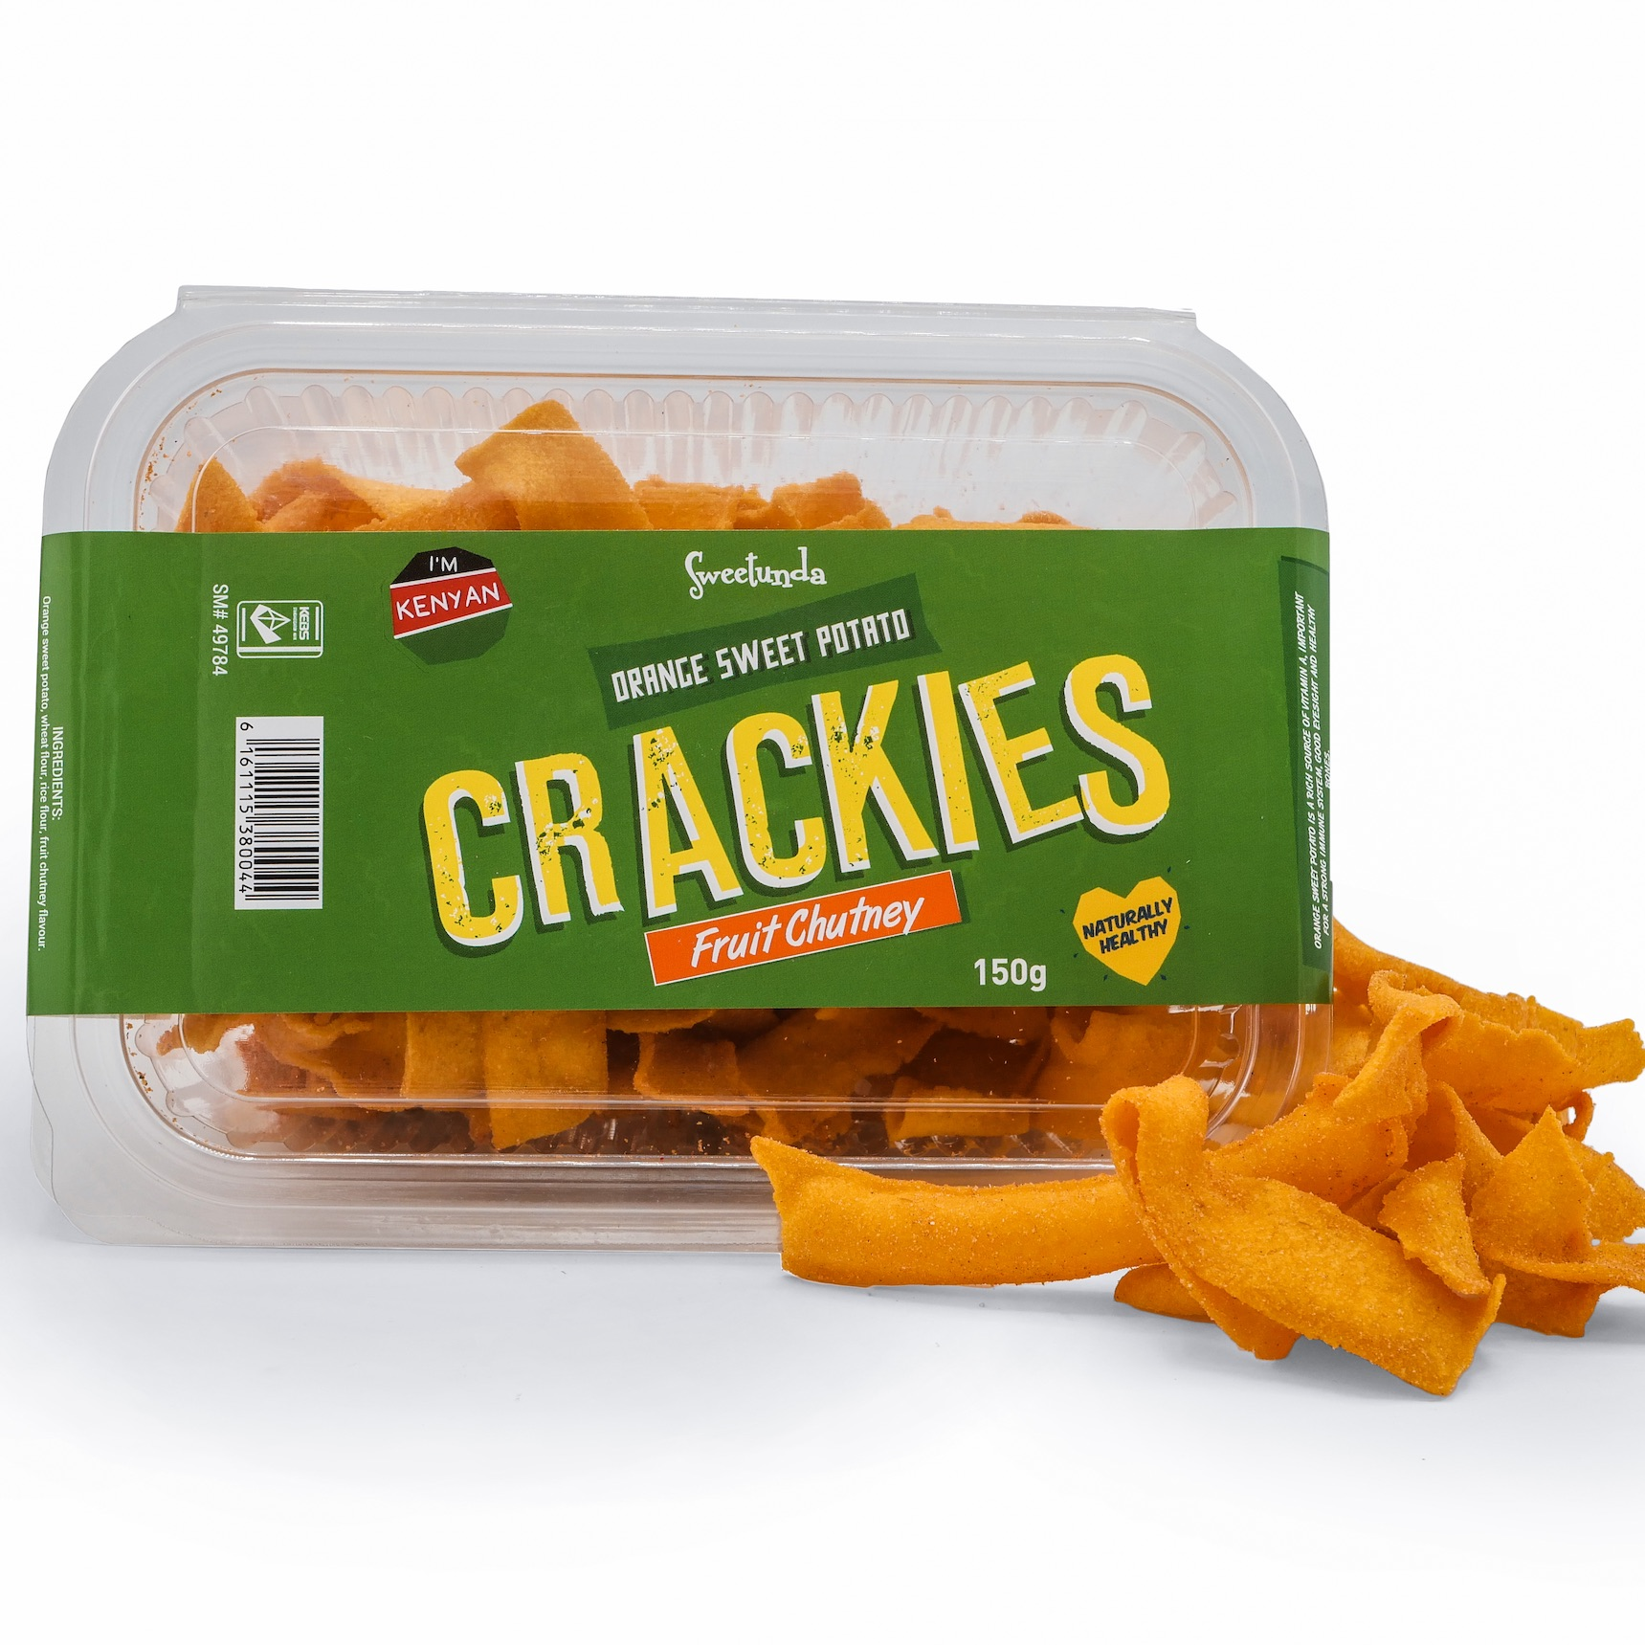
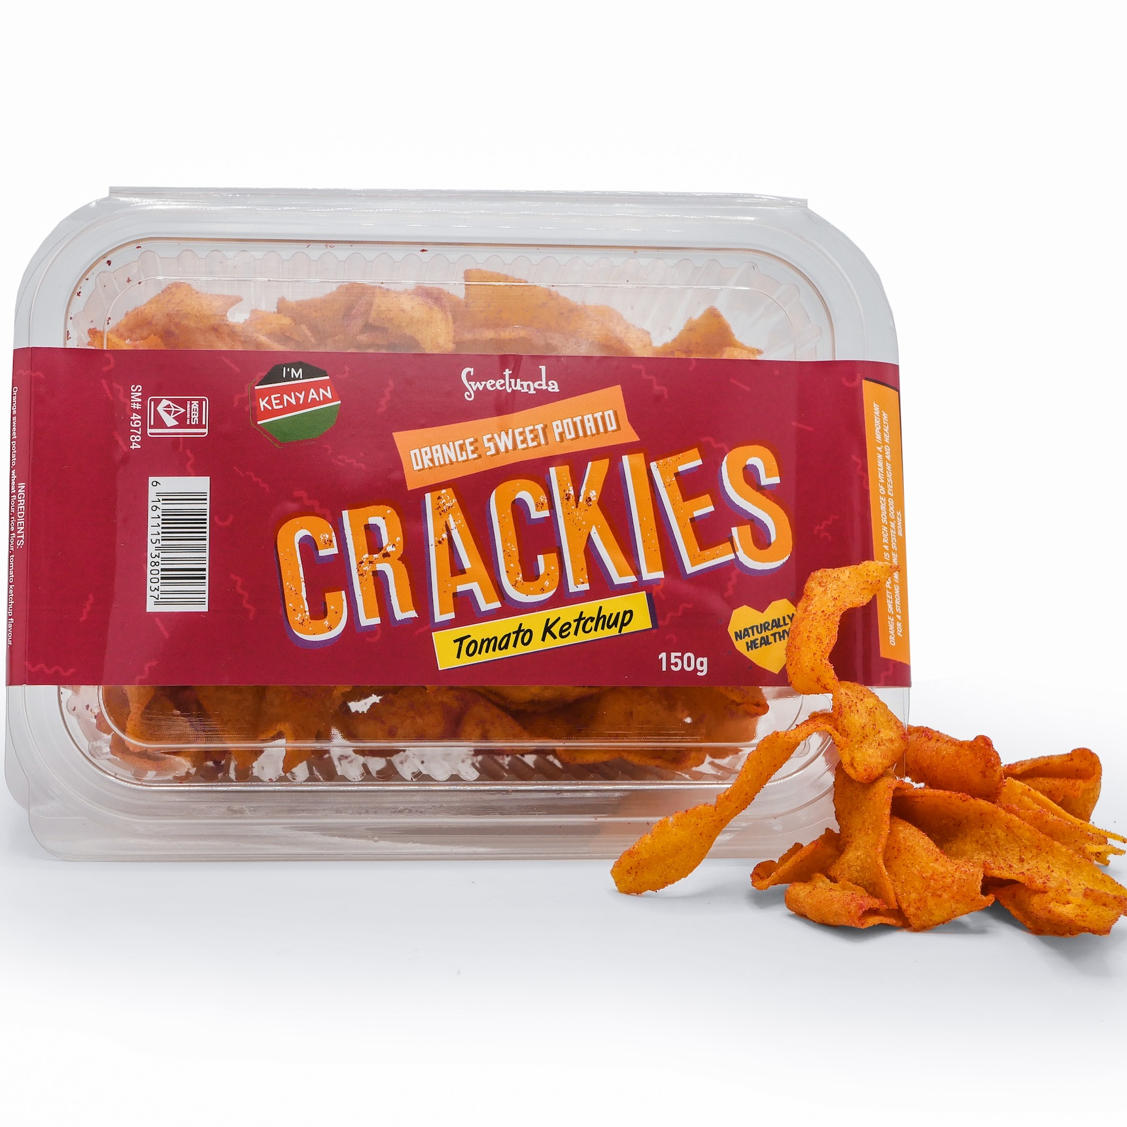
2
Notes:
Full Sweetunda range of packaging being sold into Kenyan retail market; 20g - 200g

Slide 3
About Us
OUR VISION
Be the market leading Kenyan manufacturer and distributor of healthy fruit and vegetable-based snacks and food ingredients, ensuring sustainable incomes right to the bottom of the value chain.
Burton & Bamber Co. Ltd (B&B) is a Kenyan food processing company (est. 2015) with a mission to:
Reduce food waste by creating access to market for smallholder farmers, who otherwise have no means to reach customers with their fruit and vegetable products.
Implement local value addition via dehydration, aseptic pasteurisation, extrusion and milling.
Deliver high quality made in Africa food snacks and ingredients from our FSSC22000 and KEBS certified factory, to local and international retailers and B2B customers.
Our primary value chains include mango, banana, orange flesh sweet potato (OFSP), tomato.
We have supported Global GAP training and certification for farmer groups in the mango value chain.
We also processes Global GAP certified tomato.
3
Notes:
Full Sweetunda range of packaging being sold into Kenyan retail market; 20g - 200g

Slide 4
Benefits of Global GAP in the mango value chain
Global GAP training addresses crop quality, food safety and yield.
When smallholder farmers engage in Global GAP training the following improvements can be observed :
Sensitisation to use of chemicals
Improved yield
Improved crop quality
Produce with lower, or no, residual chemicals
Fruits delivered to Burton & Bamber are:
Of a better quality
Of a higher quantity
Benefits to the smallholder farmer:
Increased income
Better farm health
4

Slide 5
Constraints of Global GAP in the mango value chain
In all instances, funding for training, certification and recertification is supplied by either B&B or donor.
The above table shows that when external funding ceases, Global GAP recertification also ceases. The cost of Global GAP is simply prohibitive and unsustainable for the smallholder farmer.
FARMER GROUP | TOTAL FARMERS | GGAP CERTIFIED FARMERS Yr 1 | GGAP CERTIFIED FARMERS Yr 2 | GGAP CERTIFIED FARMERS Yr 3 | GGAP CERTIFIED FARMERS Yr 4
Group 1 | 49 | 21 | 18 | 0 | 0
Group 2 | 53 | 53 | 53 | 53 | 0
Group 3 | 150 | 74 | 0 | 0 | -
Group 4 | 140 | 64 | 0 | 0 | -
Group 5 | 500 | 21 | - | - | -
5

Slide 6
Constraints of Global GAP in the mango value chain 2
CUSTOMER DEMAND
B&B’s current experience is that 100% of EU customers require traceability and food safety assurances, HOWEVER only 25% require Global GAP certification.
6

Slide 7
Possible Solutions
Align KS 1758 with Global GAP and introduce cooperation with Global GAP, – such that a producer who has the KS standard mark also gains an affiliate standard from Global GAP.
7

Slide 8
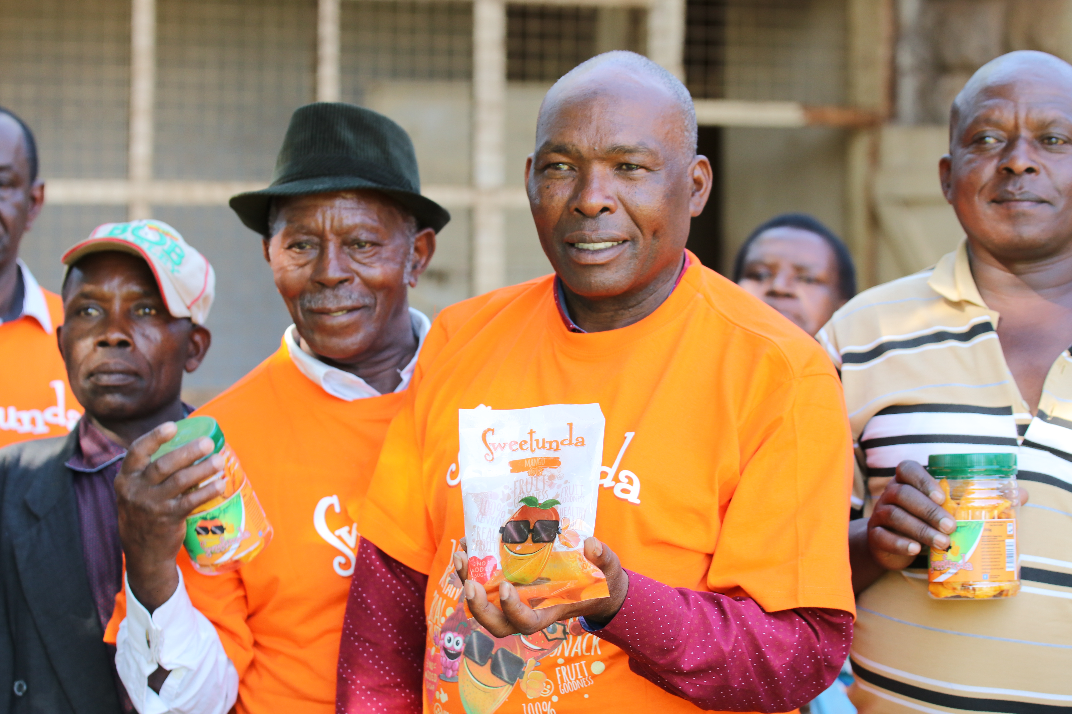
Thank you
8

