Slide 1


Supply Chain
Management System
for agribusinesses

Slide 2

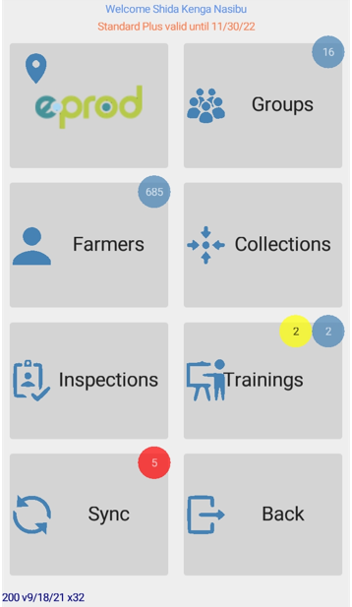
Overview of eProd
We offer an ERP for Agricultural Supply Chain Management to our clients: agricultural commodity traders, food processors and farmer cooperatives.
eProd offers an affordable, off the shelf and easy to integrate platform
optimized for low- bandwidth environments.
eProd platform is a unique data generator creating valuable information for our clients and their sector stakeholders.
Notes:
We are serving a niche market with a specialized, tested and demand driven developed software at a reasonable price. Some of the main competitive advantages are that eProd can run both on- and offline which makes it suitable for the most remote areas. Our team is experienced, service oriented and tech-savy.
eProd Solutions combines technology, agricultural experience, deep market system understanding and hands on practical experience. Our clients appreciate this

Slide 3
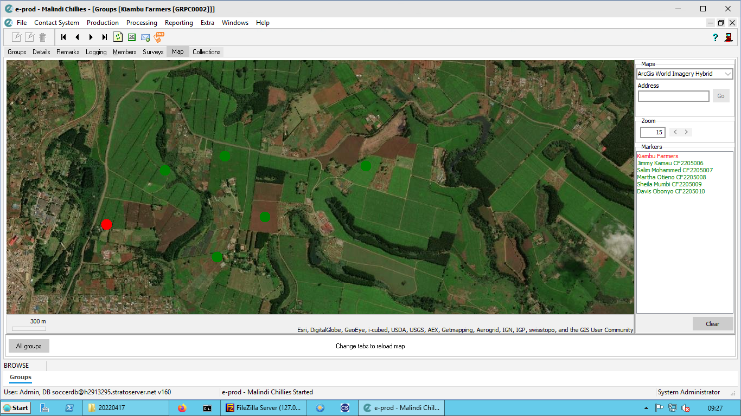

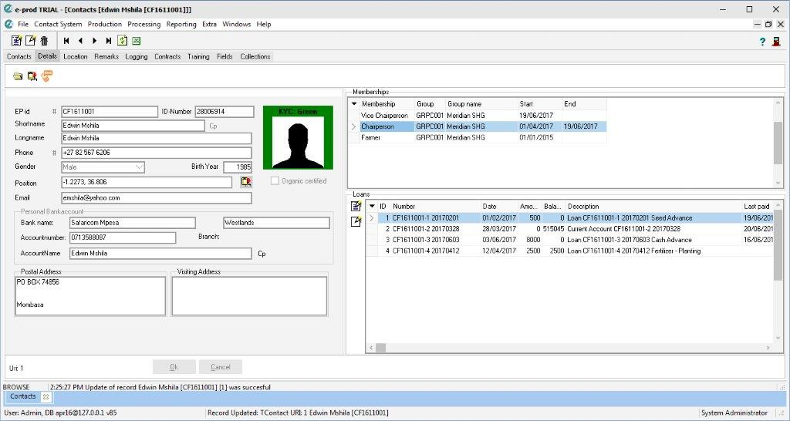


Where does eProd come in?
Collection and payment
Credit and repayment
Quality and traceability
Ag-extension services
Outgrower management
Monitoring & evaluation
Inventory management
Comprehensive farmer profiles including demographic data, planting information, past production, payments, loans, trainings, survey data etc.

Slide 4




Where does eProd come in?
Quality and traceability
Seed traceability
01
Assign traceability code to seed batches and distribute units to farmers.
Field registration
Outgrower management
Quality and traceability
Collection and payment
Credit and repayment
Ag-extension services
Inventory management
Monitoring & evaluation
02
Record planting stage, no of plants, GPS location/polygon, productivity rating and seed batch used; add surveys to fields.
Produce collection
03
Buy produce from farmers, assign a traceability code to the crate, print a receipt and link the harvest to a specific field.
Fully traceable supply chain
04
Track produce from field to collection center to processing factory and manage value addition steps.

Slide 5
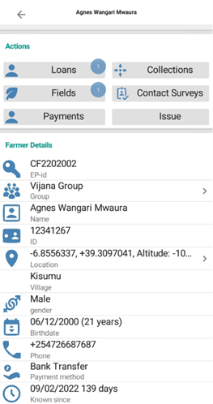
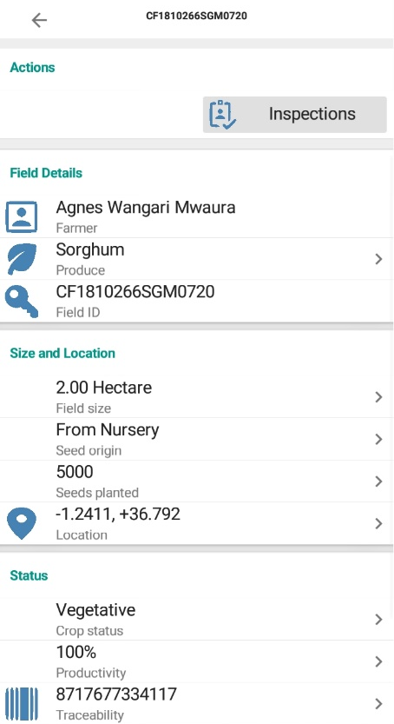
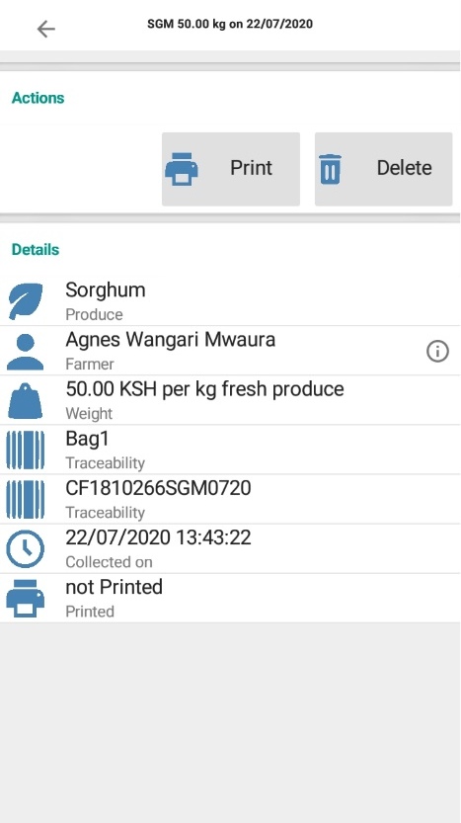


Where does eProd come in?
Produce collection
Out-grower management
Quality and traceability
Collection and payment
Credit and repayment
Ag-extension services
Inventory management
Monitoring & evaluation

Slide 6
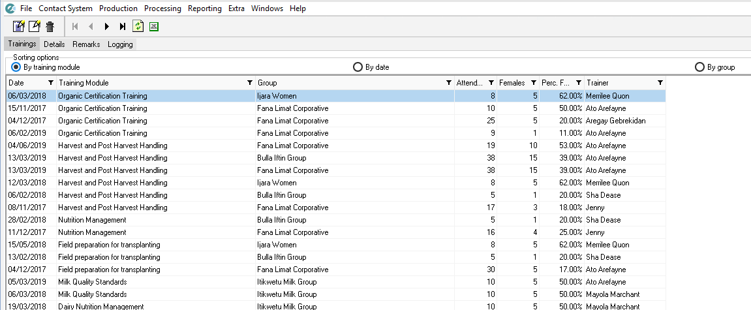
Where does eProd come in?
Farmer training
Outgrower management
Quality and traceability
Collection and payment
Credit and repayment
Ag-extension services
Inventory management
Monitoring & evaluation

Slide 7
Where does eProd come in?
Inventory management
Stock manager
Receives 100 bags of seed.
Field staff
Staff 1 receives 60 bags
Staff 2 receives 30 bags
Farmers
Receive seed on cash or on credit
Staff 3 receives 10 bags
Outgrower management
Quality and traceability
Collection and payment
Credit and repayment
Ag-extension services
Inventory management
Monitoring & evaluation

Slide 8
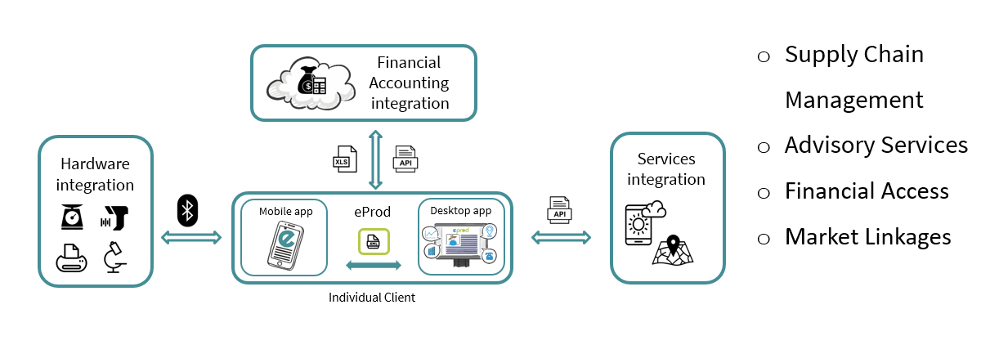
Scale Up
Offering weather and agro-advisory services
Notes:
Slide 7: Scale up plan
eProd is an ERP that can be integrated with weather forecasts, agronomic advisory services, credit scoring, etc. The various modules can work together and offer bundling of services by bringing input and output markets together.
With eProd we can offer a supply chain management, that can be used to share weather and agronomy advisory services, create access to finance, and market linkages.

Slide 9






Scale Up
Offering bundled services
Strategic partners user profiles
NGO/ GO
MFIs
Market platforms
Platform users
DWH
Mobile app
eProd
Desktop app
Mobile app
eProd
Desktop app
Mobile app
eProd
Desktop app
Individual Cooperative 1
Individual Cooperative 2
Individual Cooperative n
Notes:
Slide 7: Scale up plan
Data from multiple eProd users can come together in a data warehouse linked to BI tools. By further improving data sharing and analytical capacities we have a Unique Value Proposition for strategic partners who will link us to potential clients.

Slide 10




Thank you for your interest!
Please contact us for further discussion:
almut@eprod-solutions.com
www.eprod-solutions.com

