Slide 1


Role of laboratory testing on food safety
Rose Nyakundi - CROPNUTS

Slide 2



Role of laboratory testing on food safety
Who is Cropnuts?
1
Cropnuts is an independent agricultural testing and agronomic advisory business operating across Africa for past 22 years.
Cropnuts has local presence in Kenya, Tanzania, Zambia and Nigeria.
Offers a wide range of ISO 17025 accredited laboratory testing services, including soil, water, plant, fertilizer, animal feed & food analysis.
Also offers agronomy advisory services such as precision farming, soil survey mapping, and agronomic field support services.
Cropnuts' services are targeted towards commercial growers, agribusinesses as well as small-scale farmers.
2
3
4
5

Slide 3
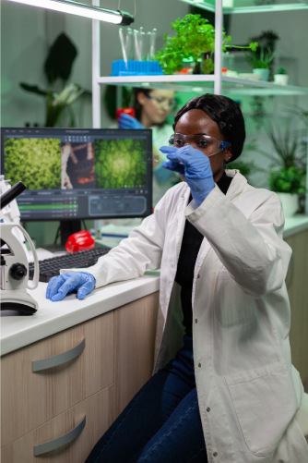
Role of laboratory testing on food safety
Introduction
Objectives of the lab
1
Avoid guess work in fertilization, pesticide application
To satisfy compliance standards
Monitoring food systems and safety
2
3

Slide 4

Role of laboratory testing on food safety
Implications of laboratory testing
1
Informed decision making
Adaptation and mitigation of climate change
Economic feasibility and validation
2
3

Slide 5

Role of laboratory testing on food safety
Our core services for vs food safety
Soil Nutrition Analysis
1
Checking for Macro and Micro elements
pH and EC, C.E.C , Total nitrogen, C/N ratio and organic matter.
Presence of heavy metals
2
3

Slide 6
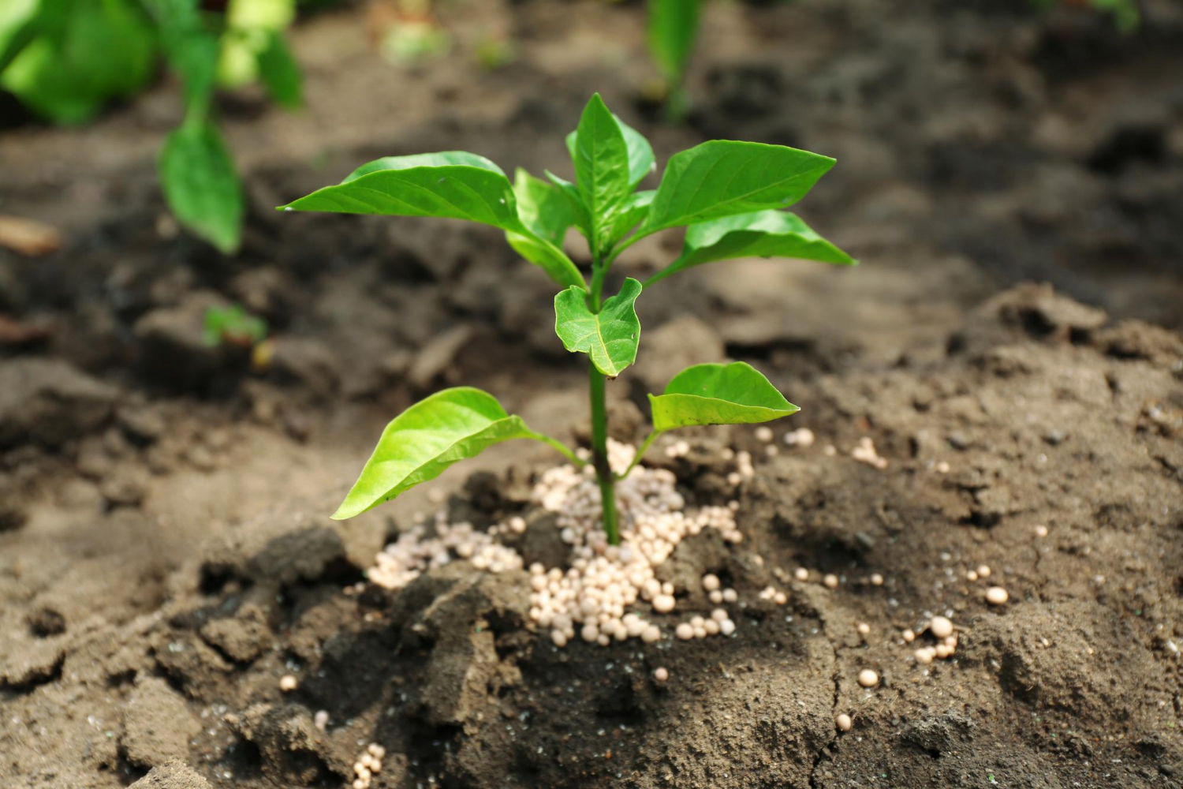
Role of laboratory testing on food safety
Fertilizers
1
Confirm the composition as specified by the manufacture
Check for heavy metals
2

Slide 7

Role of laboratory testing on food safety
Manure compost
1
Checking for Macro and Micro elements
pH and EC, C.E.C , Total nitrogen, C/N ratio and dry matter.
Presence of heavy metals
2
3

Slide 8
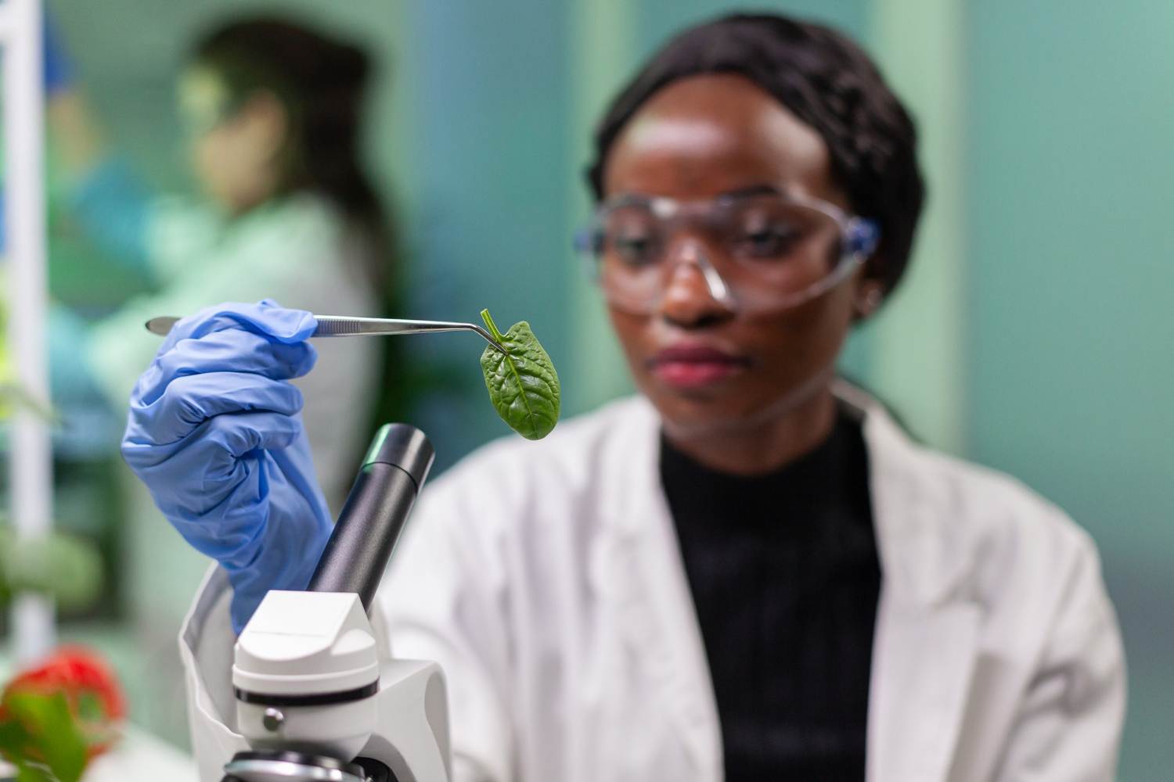

Role of laboratory testing on food safety
Pesticide residue levels
1
Crop injury caused by > 50,000 pathogens, 900 insect and mite pests and 800 weeds
Pesticides indispensable but if not used responsibly detrimental
Done in partnership with Groen Agro control Lab
Check both the pesticide active ingredients and their metabolites
2
3
4

Slide 9
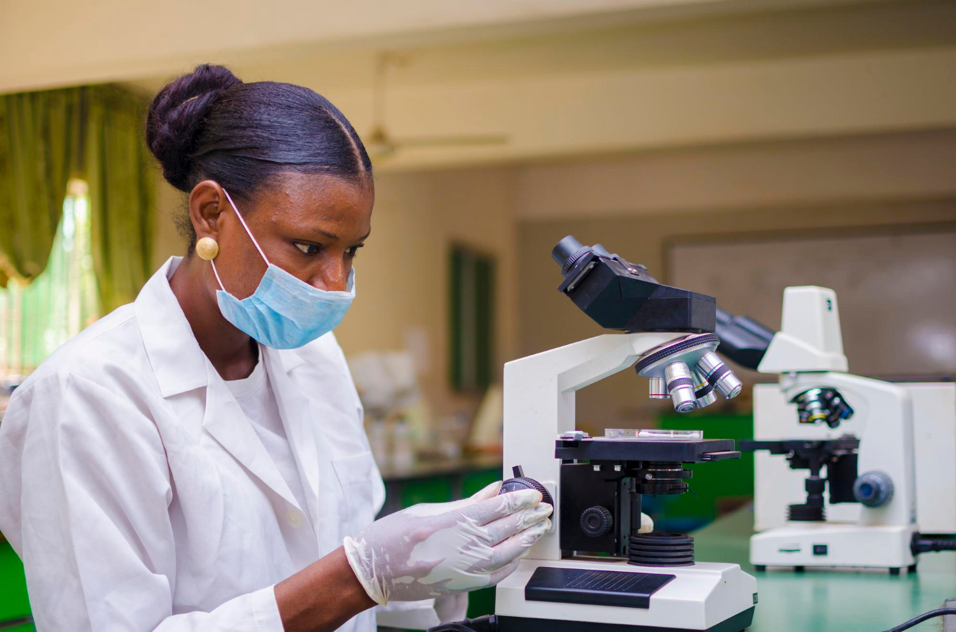
Role of laboratory testing on food safety
MRL Menace?
Entomology and pathology services are offered at CROPNUTS
Benefits
1
Customized recommendations
Customized spray program
Technical support
2
3

Slide 10

Role of laboratory testing on food safety
NEMA
This is done for compliance to the NEMA regulations on effluent water management.
Heavy metal analysis done among other parameters.
Microbial analysis done
Important that water released to the environment is safe.

Slide 11

Role of laboratory testing on food safety
Food safety
1
Aflatoxin testing in feed/ food- Total and AFB1
Microbial analysis
Heavy metals in food
2
3

Slide 12

Role of laboratory testing on food safety
Opportunity
Have a policy frame work for MRL testing for both export and local market

Slide 13

Role of laboratory testing on food safety
Remember
Laboratory analysis is crucial in
food safety management

Slide 14





Role of laboratory testing on food safety
Acknowledgement
Jeremy Cordingley
The Managing Director Cropnuts
Stephen Wanjala Wamalwa
Technical Sales (Agronomy) Cropnuts
Oscar Adika
The Digital Marketing Manager Cropnuts

Slide 15


Thank you for your attention
Crop Nutrition Laboratory Services Ltd.
Limuru, off Limuru road, P.O. Box 66437
00800 Nairobi • KENYA
+254 711 094 444 • +254 720 639 933
support@cropnuts.com • www.cropnuts.com

