Slide 1
GLOBALG.A.P. Tourstop:
Kenya
TOPIC OF SESSION:
The new IFA standard, IFA v6 Smart and GFS
Nairobi, Kenya
28-30 MARCH 2022

Slide 2
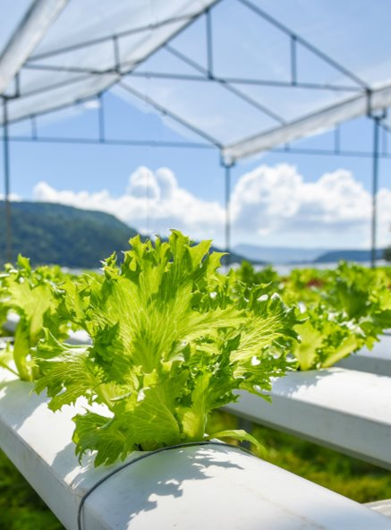

CONTENT
Introduction
What is new in the GLOBALG.A.P. Integrated Farm Assurance (IFA) standard v6
Registered Trainer program
© GLOBALG.A.P. Secretariat | 2

Slide 3





INTRODUCTION
Smart farm assurance solutions
SMART SOLUTIONS FOR YOUR FARM ASSURANCE NEEDS
THE FOUR PILLARS OF OUR SMART
FARM ASSURANCE SOLUTIONS
Smarter standards and add-ons
New and improved products, beginning with IFA v6 and GRASP v2.0.
Smarter systems and services
Audit Online Hub and Validation Service linked to improve the integrity of GLOBALG.A.P. certificates.
Smarter approach to sustainability
Continuous improvement requirements and stronger environmental criteria in IFA v6, a new biodiversity add-on, and the Impact-Driven Approach expanded to other sectors.
Smarter integration of data
For conformance, transparency, and evaluation of the whole assurance system.
© GLOBALG.A.P. Secretariat | 3
Notes:
Over the last two-three years, GLOBALG.A.P. has been coordinating the revision of its flagship Integrated Farm Assurance (IFA) standard as well as other GLOBALG.A.P. rules, standards, and systems. Over the course of the revision process, it became clear that this included much more than just a new version of the IFA standard.
Starting in April 2022 and spearheaded by our new and improved IFA v6, we are updating our whole portfolio of farm assurance solutions, including our services, to offer more streamlined, intuitive, and digitalized solutions for the entire sector.
We are entering the smart era!

Slide 4
INTEGRATED FARM
ASSURANCE (IFA) v6

Slide 5

IFA v6 DEVELOPMENT
GLOBALG.A.P. standards are developed by the industry, for the industry.
To develop IFA v6 FV, three public consultation periods took place over two years. All stakeholders from the industry were invited to participate and give feedback.
There were 79 virtual World Consultation Tour meetings on FV topics.
We received over 2,300 comments on the IFA v6 FV documents.
The revised standard addresses the needs and demands of the market.
© GLOBALG.A.P. Secretariat | 5

Slide 6
TRANSITION TIMELINE
IFA v6
V5.4-1-GFS remains valid until three months after IFA v6 GFS receives GFSI recognition.
The exact date for this is still unknown.
October 2022
IFA v6 final documents published
(English)
December 2023
Last month to complete an
IFA v5.2 audit
Add-ons in process to be updated
July 2023
Publications of NIGS for IFA v6 begins.
January 2024
IFA v6 Smart obligatory
© GLOBALG.A.P. Secretariat | 6

Slide 7







EXECUTIVE SUMMARY – WHAT IS IFA V6?
It takes a holistic approach to farm assurance through the following topics:
FOOD SAFETY
LEGAL, MANAGEMENT, TRACEABILITY
PRODUCTION PROCESSES
ENVIRONMENTAL SUSTAINABILITY
ANIMAL HEALTH AND WELFARE
WORKERS’
WELL-BEING
RESPONSIBLE FARMING PRACTICES
© GLOBALG.A.P. Secretariat | 7

Slide 8
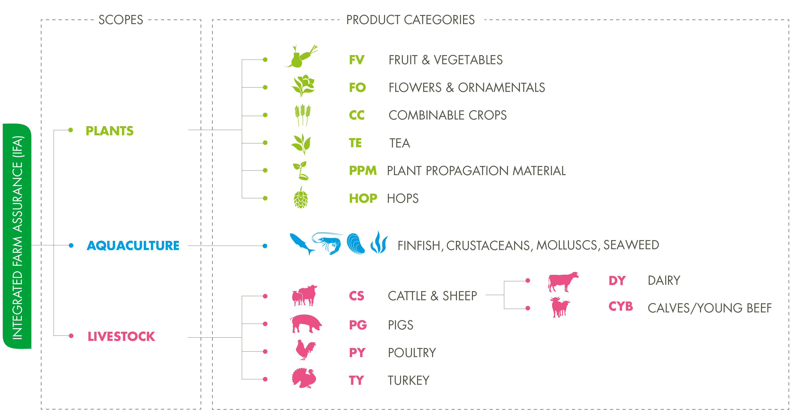


SCOPES AND PRODUCT CATEGORIES
An explanation
IFA v6 is still considered to be one standard, applicable for multiple scopes and product categories. Each product category has its own checklist.
Crops scope now
called plants
Sub-scopes
now called
product categories
© GLOBALG.A.P. Secretariat | 8

Slide 9





VERSION 6
Two editions: General
IFA v6 Smart
IFA v6
GFS
© GLOBALG.A.P. Secretariat | 9
Notes:
NOTES FOR THE TRAINER:
HOP and FO product categories are available only for the IFA Smart edition while FV and AQ are available for both editions.

Slide 10






TWO IFA V6 EDITIONS
An overview
IFA v6 Smart
Flagship edition for the majority
By stakeholders, for stakeholders
Six topics for responsible farming practices
100% outcome-oriented, customizable checklists
IFA v6 GFS
For those who need certification with GFSI recognition
Driven largely by US markets
Six topics for responsible farming practices
Adapted for GFSI recognition (not 100% outcome oriented)

Slide 11
TWO IFA V6 EDITIONS
A comparison - Similarities
Similarities
Both evolved from IFA v5
Same six topics
Environmental sustainability, and workers’ well-being covered in the same way
Content and user experience closely aligned
© GLOBALG.A.P. Secretariat | 11
Notes:
Similarities
Both have evolved from IFA v5 with full support from GLOBALG.A.P. technical committees.
Same six topics, same holistic approach.
The topics of environmental sustainability, and workers’ well-being are covered in the same way in both editions.
Content and user experience have been aligned as closely as possible.

Slide 12
TWO IFA V6 EDITIONS
A comparison - differences
Differences | Differences
1. General regulations for GFS edition includes some extra/more strict requirements. | 4. There is one extra P&C in the GFS edition for FV (190 vs. 191 total).
2. Less than 15% of the P&Cs in the GFS and Smart editions differ from each other. | 5. Compliance levels: GFS edition has P&Cs graded as Major Musts, while the corresponding points in v6 Smart are Minor Musts.
3. P&Cs of legal, management and traceability, food safety, and production processes are more prescriptive to accommodate GFSI benchmarking. | 6. Remote audit (fully remote) only possible under Smart edition.
© GLOBALG.A.P. Secretariat | 12
Notes:
Differences
V6 Smart is intended for the majority of producers, v6 GFS is specifically adapted for GFSI.
General regulations for GFS edition have a few extra requirements. E.g. unannounced have no 48h notification period
The principles and criteria (P&Cs) relating to the topics of legal, management and traceability, food safety, and production processes are more prescriptive to accommodate GFSI benchmarking.
Less than 15% of the P&Cs in the GFS and Smart editions differ from each other.
There is one extra P&C in the GFS edition for FV (190 vs. 191 total).
Compliance levels: GFS edition has 15 more P&Cs graded as Major Musts, while the corresponding points in v6 Smart are Minor Musts.
Recertification audit: Remote audit (fully remote) is included as an emergency procedure for the Smart edition only. Initial certification based on a fully remote audit is not possible.

Slide 13
OUTCOME-ORIENTED APPROACH
What is it?
The IFA v6 approach focuses on the outcomes achieved, rather than the specific measures.
“Control points” and “compliance criteria” from IFA v5 are therefore replaced by “principles” and “criteria” in IFA v6.
Principles
Rules that set the foundation of a GLOBALG.A.P. requirement.
Statement instead of question form.
Describe the outcome to achieve.
Criteria
Methods that producers can use to demonstrate a principle to be true.
Compliance can be evidenced by data, a procedure, a record, etc.
© GLOBALG.A.P. Secretariat | 13
Notes:
The IFA v6 approach focuses on the outcomes achieved, rather than the specific measures. This provides greater flexibility as it allows producers to demonstrate compliance in a way that is most appropriate for their production practices.
“Control points” and “compliance criteria” from IFA v5 are therefore replaced by “principles” and “criteria” in IFA v6.

Slide 14
STREAMLINED, CUSTOMIZED CHECKLISTS
How is this achieved?
Reduced number of principles and criteria in IFA v6 compared to IFA v5.
Checklists are now customized, based on the producer’s specific situation.
Fruit and vegetables (Smart)
Flowers and ornamentals
Level | V5 | V6
Major Must | 93 | 103
Minor Must | 114 | 67
Recommendation | 15 | 20
TOTAL | 222 | 190
Level | V5 | V6
Major Must | 64 | 67
Minor Must | 116 | 77
Recommendation | 17 | 14
TOTAL | 197 | 158
-32
-39
© GLOBALG.A.P. Secretariat | 14

Slide 15
TWO IFA V6 EDITIONS
Principles and criteria – fruit and vegetables (IFA Smart and GFS)
Workers’
well-being:
22
Food safety:
43 (44 in GFS edition)
Category level | Principles & Criteria
Major Must | 103 (Smart edition) 118 (GFS edition)
Minor Must | 67 (Smart edition) 53 (GFS edition)
Recommendation | 20
TOTAL | 190 (Smart edition) 191 (GFS edition)
Production processes:
33
Environmental
sustainability:
69
Legal, management, and traceability:
23
© GLOBALG.A.P. Secretariat | 15

Slide 16
STANDARD CONTENT
Principles and criteria – flowers and ornamentals (IFA Smart)
Legal, management, and traceability:
22%
Production processes:
28%
Category level | Principles
Major Must | 67
Minor Must | 77
Recommendation | 14
TOTAL | 158
Workers’
well-being:
19%
Environmental sustainability:
31%
© GLOBALG.A.P. Secretariat | 16

Slide 17
A STRONGER FOCUS ON SUSTAINABILITY
How?
Environmental sustainability is a major focus of IFA v6.
New sustainability topics in IFA v6:
Greenhouse gases and climate change
Ecosystem restoration
Food waste management
Plastics management
Carbon neutrality
Deforestation prevention
Animal welfare
The farm as an agricultural ecosystem
Continuous improvement
© GLOBALG.A.P. Secretariat | 17

Slide 18

COSTS
IFA v6 contains three cost elements.
Note: Each farm is unique, and the final costs
depend on a combination of factors
(size, location, existing policies and processes, etc.)
1. Implementation costs: Incurred by the producer to prepare for the CB audit
2. CB service fees: Determined by the CB to cover audit time and travel costs
3. System participation fee: (NEW)
© GLOBALG.A.P. Secretariat | 18
Notes:
System participant fee is linked to production type; option and amount of Ha per crop (including crop cycles),

Slide 19
REGISTERED TRAINER
PROGRAM
Notes:
NOTES FOR THE TRAINER:
Here we introduce you the new Registered Trainer Program for GLOBALG.A.P. Standards.

Slide 20



REGISTERED TRAINER PROGRAM
Registered Trainer Program
Time to Improve
Stopped end of 2021
Thank you for 10 Years Farm Assurer Program
PURPOSE:
support producers to become GLOBALG.A.P. certified
© GLOBALG.A.P. Secretariat | 20

Slide 21
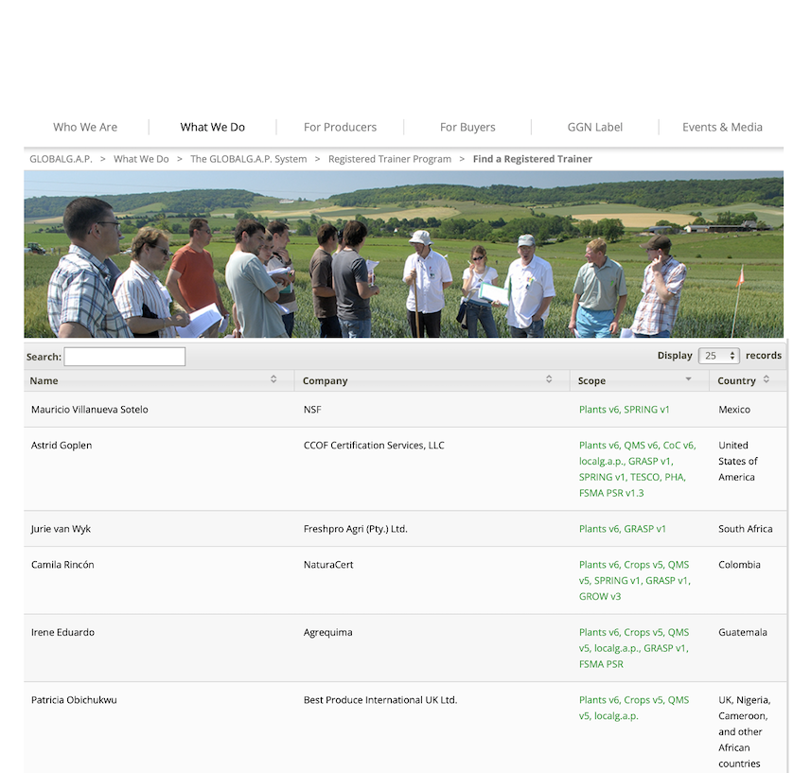

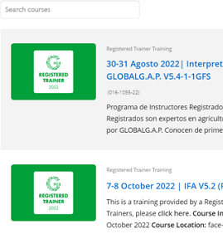
BENEFITS FOR REGISTERED TRAINERS
Extra visibility
Public affiliation
Training promotion
© GLOBALG.A.P. Secretariat | 21
Notes:
The registered trainer program offers 6 benefits.
Extra visibility: Your name and company are listed on the GLOBALG.A.P. website and included in publications (under information regarding Registered Trainers). Future clients can find and contact you easily using the “Find a Registered Trainer” function on our website.
Public Affiliation: with the GLOBALG.A.P. brand, including free use of a GLOBALG.A.P. seal for Registered Trainers. This seal is updated yearly and can be used in your communication channels and on marketing materials. Use of the Registered Trainer seal confirms your status as an approved training provider and adds value to your business with a trusted global brand name.
Training Promotion: in the GLOBALG.A.P. Registered Trainer course catalogue. Your training will be visible to all visitors on the GLOBALG.A.P. Academy website, providing an additional platform for potential clients to find your trainings.

Slide 22
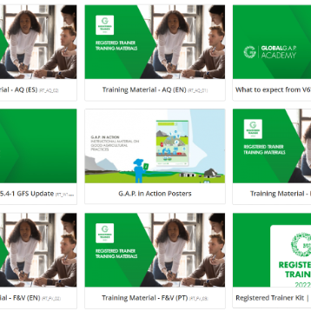


BENEFITS FOR REGISTERED TRAINERS
Lifelong learning
Free training material
Priority status
© GLOBALG.A.P. Secretariat | 22
Notes:
Continued from previous slide: Benefits for Registered Trainers:
Lifelong learning: Registered trainers have access to free webinars on new topics to ensure up-to-date knowledge on GLOBALG.A.P. topics such as localg.a.p., GRASP, etc.
Free materials for their workshops: GLOBALG.A.P. training material and the G.A.P. in Action posters are freely available to registered trainers. We will offer these training materials in English and Spanish and, if requested, in Arabic, French, Greek, Italian, Japanese, Portuguese, and Turkish. With these materials Registered Trainers will be best prepared to lead training sessions. We also provide a certificate template for their participants.
Priority status: Registered Trainers have direct contact with the responsible person for the program.

Slide 23
REGISTERED TRAINER APPLICATION PROCESS
Registered Trainers must:
Attend an Integrated Farm Assurance (IFA) course or an In-House Trainer training (if you are working for a certification body) provided by GLOBALG.A.P.
Pass the subsequent exam with a minimum score of 80% in each part
Complete the registration form
When you have been approved, we will issue the invoice and once paid, you will be able to access all your benefits.
registered_trainer@globalgap.org
© GLOBALG.A.P. Secretariat | 23
Notes:
In order to ensure that registered trainers have an adequate level of GLOBALG.A.P. knowledge, applicants to the program must go through an approval process. This includes:
Participation in a IFA course or the In-house-trainer Training for candidates from Certification Bodies
Achieving at least 80% in a proctored exam
Registering for the program via the online application form
Signing the terms and conditions

Slide 24
Number of Registered Trainers in East Africa
REGISTERED TRAINER PROGRAM FOR GLOBALG.A.P. STANDARDS
 | 2018** | 2019** | 2020** | 2021** | 2022*
Tanzania | 1 | 1 | 0 | 2 | 9
Ethiopia | 5 | 5 | 6 | 6 | 4
Uganda | 0 | 0 | 0 | 0 | 0
Rwanda | 0 | 1 | 1 | 1 | 1
Kenya | 3 | 5 | 5 | 5 | 11
Globally - 258
* Only up to Dec 22, Registered Trainers
** Number of Farm Assurers
© GLOBALG.A.P. Secretariat | 24

Slide 25

THANK YOU TO ALL OUR SPONSORS!
© GLOBALG.A.P. Secretariat | 25

Slide 26



THANK YOU FOR YOUR ATTENTION!
Questions – Discussion – Contact Us
Name: Christi Venter
Senior Technical Expert /
Team Leader Training Development
venter@globalgap.org
www.globalgap.org

Slide 27
Disclaimer: This presentation, training material, or publication is the property of GLOBALG.A.P. c/o FoodPLUS GmbH. The GLOBALG.A.P. approved Certification Body or Registered Trainer may use it and its content in internal and external trainings in unaltered format. GLOBALG.A.P. does not assume any responsibility for the training carried out by third parties using this material.
© GLOBALG.A.P. Secretariat

